Slide 1



The Nuts and Bolts of Telemedicine:
Essentials For a Family-Centered Experience
Notes:
Welcome to The Nuts and Bolts of Telemedicine: Essentials for a Family-Centered Experience
Introductions
Housekeeping
Recording
Use of chat, etc
Engaging ACTIVITY

Slide 2

This program is supported by the Health Resources and Services Administration (HRSA) of the U.S. Department of Health and Human Services (HHS) as part of an award totaling $1,000,000 with 0% financed with non-governmental sources. The contents are those of the authors and do not necessarily represent the official views of, nor an endorsement, by HRSA, HHS, or the U.S. Government. For more information, please visit HRSA.gov.
Notes:
First I would like to start off with a statement from our funders,
READ
“This program is supported by the Health Resources and Services Administration (HRSA) of the U.S. Department of Health and Human Services (HHS) as part of an award totaling $1,000.000 with 0% financed with non-governmental sources. The contents are those of the authors and do not necessarily represent the official views of, nor an endorsement, by HRSA, HHS, or the U.S. Government. For more information, please visit HRSA.gov.”

Slide 3
Participants will be able to:
Identify options for getting connected to participate in a Telehealth appointment.
Determine what devices can be used to attend a Telehealth appointment.
Understand the difference between portals and platforms used for Telemedicine.
Explain what needs to be done before, during and after your Telehealth visit.
Learning Objectives
Notes:
While some of you may have had experience with telemedicine in the past, COVID 19 made telemedicine not only an option, but – in many cases – a necessity for most of us.
Unfortunately, if you had no experience with telemediciine there may have been a steep learning curve – especially for those who would describe themselves as not being ‘tech savvy.”
We hope to help you: OBJECTIVES

Slide 4
What do we mean when we say…
Telemedicine | Telehealth
Often used interchangeably with “telehealth” Focused on the clinical aspect of care a video appointment with your child’s pediatrician a virtual therapy session with your young adult’s speech therapist | Using electronic information and communication technologies, such as: Video chat Internet Wifi to support things like: long-distance health care health-related education public health health administration
Notes:
Let’s start eight some definitions to make sure we understand one another.
Telemedicine is often used interchangeably with “teleheatth” (I do so myself).
Technically, telemedicine is the clinical aspect of care, that is, an appointment with a physician or healthcare provider,
It could also be a virtual therapy session with a speech, occupational, or physical, or other type of therapist.
Telehealth, in the other hand, is the use of electronic information and telecommunication to provide clinical health care, health related education, public health, and health administration information.
These can be done in many ways.

Slide 5
The Nuts and Bolts of Telemedicine
Are You
Connected?
1
Essentials For a Family-Centered Experience
Notes:
Perhaps one of your first challenges was connecting with your provider.
Doing something new and different can always be more difficult.
It may continue to be complicated because there is not ONE way of doing this.
Tell-anything starts with some sort of connection.

Slide 6
What does “being connected” mean?
The ability to send and receive data through space
  Phone calls
  Text messages
  Emails
  Posting pictures on social media
  Video chats
Cellular/Mobile vs. Internet/Broadband Connections
Notes:
“Data” can be a lot of different things; for instances you could make a phone call - your voice is data being transmitted on phone lines or, if using a mobile service, through the air.
When you send text messages and that is data. All of letters that make words are data.
Sending an email, posting a photo on social media, video calls and telemedicine appointments with your child’s doctor all are data. Many of these involve a lot of data because they use multiple forms at the same time. For example, using my voice and video or pictures take quite a bit more data.
You can “Be Connected” in all of these ways to share or receive data.

Slide 7
Some Options for Getting Connected in your Community
if you are not Connected at Home
Coffee Shop
A Gathering
Place
(Chapter House,
General Store)
Library
Community
Center
Lifeline
Fast Food
Restaurant
Family Voices
Office
(or other
community
provider)
School
Cultural
Center
Notes:
Sometimes your internet or mobile network because of location, strength, or use and overuse make it difficult to send and receive date.
For example… mention a couple… ask them to put other ideas in chat.
There are options for getting connected in your community if you do not have access to a connection at your home or if it is not adequate:
Community center: one option would be to drive or visit a community center near your location that might have wireless internet.
Many fast food restaurants offer Wi-Fi with the purchase of a meal or food so that can be a place to access internet as well.
Cultural liaison Hub or Cultural Center these might also be places to find access.
Almost all libraries have access to Internet and some even have private rooms that you could reserve to have a quiet spot away from those who are reading and studying.
A Gathering Place in your community such as a chapter house or a general store might also be places with active hotspots or allow their visitors to access the internet.
Family Voices Offices or other community providers might be a place where you can get assistance with getting connected. We already mentioned coffee shops as well and also as you probably know our schools offer a place to connect when school is in session.
“Lifeline” is not a physical place to connect to the internet but it is a means to help finance and pay for internet services if that is a concern for your family and a barrier for you not being able to have internet at your home or at another place. Lifeline is a federal program and we have some more information and resources on how to access that.
Suggestion – Share with audience that some internet and cellphone providers are offering hotspots free of charge, throughout many states.

Slide 8
The Nuts and Bolts of Telemedicine
Do You Have
a Device?
2
Essentials For a Family-Centered Experience
Notes:
Another important aspect of Telemedicine is having a device, but just hat do we mean when we say “decide”?

Slide 9
Categories and Examples
of Devices
Computers
Laptop
Desktop
Chromebook
Tablets
iPad
Kindle Fire
Microsoft Surface
Smart Phones
Android
iPhone
Galaxy
Notes:
There are 3 main categories for Devices that we will dive into more detail about today: Computers, Tablets and Smart Phones.
Chat in what you use for your Telemedicine visits.

Slide 10
The Nuts and Bolts of Telemedicine
Can You ‘See’
Your Provider?
3
Essentials For a Family-Centered Experience

Slide 11
How Do I ‘See’ My Provider?
To see your provider for a telemedicine appointment, you will need software.
This software is often called a platform which may be accessed through a portal, so you can see your provider and so your provider can see you.
Most often, the Provider will choose the way you will “see” them by picking which platform/portal their practice uses for their telemedicine appointments
Platform | Portal
A secure telehealth software system which allows a provider and a patient to have a secure two-way video interaction for a virtual visit | A website or webpage providing access or links to other sites
Notes:
In today’s webinar we are going to discuss SOFTWARE, specifically portals and platforms..
To see your provider for a telemedicine appointment, you will need software. This software is often called a platform which may be accessed through a portal, so you can see your provider and so your provider can see you.
What exactly is a portal and a platform?
Example- the zoom software that allows you to have a video interaction for your appointment.
Portal-
A website or web page providing access or links to other sites. In healthcare settings, it may include access to electronic medical records, messaging your doctor, online appointment scheduling and access to telehealth appointments
Example: MyChart at your children’s hospital for specialist visit
Since the Provider chooses the way you will “see” them by picking which platform their practice uses for their telemedicine appointments, again if you are unsure of which platform your provider uses, Contact your Provider… ahead of appointment to ask.

Slide 12









Examples of Platforms and Portals
Amwell
Microsoft Teams
Skype
Hospital Portals
eVisit
VSee
Zoom
Doxy.me
MyChart
You may have to use different methods to see various
providers for telemedicine appointments.
For instance, your child’s pediatrician may use zoom and their
pediatric cardiologist may use the hospital portal.
Notes:
The words Portal/Platform and Website/App/Software
are sometimes used interchangeably to mean the way you as a patient can see your provider for a telemedicine appointment.
There are over 150+ possible ways or platforms out there to see your provider.
We are going to pick a few common platform to describe.
If you are unsure of which platform your provider uses, Contact your Provider… ahead of appointment to ask.

Slide 13


Just as you must enter the exam room to see your doctor for an appointment in person, you will also have to open a Virtual Exam Room “Door”
to ‘See’ Your Doctor
Notes:
Just as you have to enter the exam room to see your doctor in person … you also have to open an “electronic door” to see our providers for a telemedicine appointment.
Just as at the office, your privacy and confidentiality are important.

Slide 14
4 Keys
Email
Text
Log-In
Call Your Provider
In-person visits do not require a real key to open the exam room door but for a telemedicine or virtual visit,
a “key” is necessary to protect your identity and for your security and confidentiality purposes.
Notes:
What are some of the keys?
Here are 4 keys to open the virtual door to ”see your provider; they are:
Email, Text, Log-In, and to Call your provider.
Of course, you don’t need a real key to open an exam room door for your in-person visit, in order to protect your identity and for your security and confidentiality, you will need one of these virtual “keys” to access your telehealth visit.
Different providers may use different keys to open their virtual exam room door.

Slide 15
Login Words to Know
Username
Website/Webpage
Password
A webpage is a specific collection of information provided by a website and displayed to you in a web browser. Webpages can be thought of pages in a book and the website is the book.
Software
Software can be the programs, applications or apps, and operating instructions for the computer(or hardware).
Apps
short for "application," which is the same thing as a software program. It is most often used to describe programs for mobile devices, such as smartphones and tablets.
Notes:
There are some Login Words to Know
Just like an email account, most telemedicine systems will require a Username, Login, and Password
Like email, these words mean essentially the same thing, but now instead of accessing your email account you will be using a username and password to login to a health portal.
Website/Webpage
A webpage is a specific collection of information provided by a website and displayed to you in a web browser. Webpages can be thought of pages in a book and the website is the book
Software
Software can be the programs, applications or apps, and operating instructions for the computer(or hardware).
Apps
short for "application," which is the same thing as a software program. It is most often used to describe programs for mobile devices, such as smartphones and tablets.
Suggestion: Give examples of each of these. Use examples that are familiar to participants. You may want to ask audience to share examples that they are aware of to increase engagement. You can use a poll in Zoom to test their knowledge on these. Also, if you want to customize slides, you can use other pictures to represent each of the words.

Slide 16
A Word About HIPAA
Health Insurance Portability and Accountability Act
HIPAA is a law about health information.
HIPAA creates rules about the ways that private and protected health information (sometimes called “PHI”) can be shared, stored and used by anyone other than the person it is about.
Most of your health information is protected under HIPAA, including all personal information that could be used to identify you, such as: previous health history, health status, or payment information.
HIPAA doesn’t protect the health information that doesn’t explicitly link to you. This means that any health data that is more or less anonymous can be added to medical databases
Notes:
HIPAA stands for Health Insurance Portability and Accountability Act and is usually called “HIPAA,”
It is a law about health information with rules about the ways that private health information (sometimes called “PHI”) can be shared, stored and used by anyone other than the person it is about.
Most of your health information is protected under HIPAA, including all personal information that could be used to identify you, like your previous health history, health status, or payment information. However, HIPAA doesn’t protect the health information that doesn’t explicitly link to you. This means that any health data that is more or less anonymous can be added to medical databases.

Slide 17
During a Public Health Emergency (PHE)
During the PHE, providers can use non-HIPAA compliant platforms, if it is done so in good faith, and the platform is non-public facing.
So during a public health emergency a provider could use a platform like FaceTime, Facebook Messenger, Skype (traditional), etc.
However, they cannot use products like Twitch, Facebook Live, TikTok, YouTube, etc.
HIPAA
Notes:
During a Public Health Emergency, providers can use non-HIPAA compliant platforms. A platform is just a digital way to connect people.
Non-HIPPA compliant platforms have to be used in good faith, and must be non-public facing, meaning that only the people who are intended to be connected are, in fact, connected.
This means they can use things like FaceTime, Facebook Messenger, Skype (traditional), etc. They cannot use products like Twitch, Facebook Live, TikTok, YouTube, etc.
Suggestion: Mention that these apps are not sharing your health information with anyone else.

Slide 18

Most Platforms include:
Video Calls
Video Chat
Shared Screen
HIPAA Compliance
Other tasks you can do in a Portal:
Schedule an appointment
Give a family access to their child’s medical records
Message your provider
Pay Your Bill
View List of Medications
View Health Profile
Get Directions
Find a Doctor in the system
Notes:
Most Platforms include:
Video Calls
Video Chat
Shared Screen – Suggestion: Explain shared screen for audience and give example
HIPAA Compliance
Portals are provided by health organizations and allow you to do several things. For example, in. Auroral you can:
Schedule an appointment
Give a family access to their child’s medical records
Message your provider
Pay Your Bill
View List of Medications
View Health Profile
Get Directions
Find a Doctor in the system

Slide 19

Family
Stories
A grandmother was attempting to schedule a visit for her granddaughter. The pediatrician’s office tells her they can see her with a telemedicine appointment.
Grandmother: “How do I do that?”
Pediatrician’s office: You will receive an email 24 hours prior to your visit
Grandmother: She hangs up and says to herself,
“I feel unsure”. She calls back to the office: “Could we do it by phone?”
Pediatrician’s office: Yes! The doctor can call you instead of doing a video call.
“Ahh!” The grandmother felt relieved.
Let’s talk about a Family Experience with ‘Seeing’ their Provider…
Notes:
Let’s talk about A Family Experience with ‘Seeing’ their Provider…
A grandmother was attempting to schedule a visit for her granddaughter. When she called, they said that the provider could see her through telehealth. The grandmother asked how she would access the appointment because she was unsure. The doctor’s office told her that an email link would be sent to her 24 hours prior to the visit. The grandmother got off of the call and felt unsure of what to do or how to see her granddaughter’s provider. She called back to the office and said that she was not comfortable doing it on the computer and asked was there any way to complete the visit by phone. The doctor’s office said that the doctor could call her instead of doing a video call. The grandmother felt relieved and was able to participate in her granddaughter’s appointment
Engagement suggestion: Have a live scenario and have the audience participate with roll playing. You could do break rooms if using Zoom.

Slide 20

Who can help?
Call the Provider and pick option to speak to nurse.
Reach out to your Provider/Staff to ask for a walk through.
Ask the Provider if you can be seen in their office using their equipment, where someone can assist (the provider can be in different location)
Ask a
Teenager
Individuals at your
place of Worship
Library
Staff
PEAL
Staff
Neighbor
Phone a friend
In Your Community
Notes:
Sometimes telemedicine can be difficult. If you are having problems, are confused or anxious about a telemedicine appointment, there are ways to get help.
# 1 Call your Provider.
Someone from practice can cal and walk you through what to expect
Often portals have videos to show you how the appointment will work
Call ahead and as soon as possible if something is not working
Ask about telephone or in person options
COMMUNITY
Often our children are very tech savvy and can help
DELETE?
Wanting to do an appt via telemedicine but that is not available, referred to urgent care/ER, resorted to insurance telemedicine
Patient going to the clinic and doctor is on video,
4. Just note that you may be seeing your provider- your location or your providers may be different depending on the situation- location/hub.
5. Policy stuff- there are a lot of things in place right now… for COVID that may or may not remain in place
6. Calling the nurse line/advice line for the clinic (pick the option to speak with someone NOW) to let them know if your platform is working.
7. When person can’t do links/technology… reach out to the provider to do by phone
8. Asking about in-person options/comfort level
9. Looking on online tutorials /you can learn anything on YouTube
10. Neighborhood/ reach out to community
11. Advocate for multigenerational inclusion
12. Ask your teenager!
13. Phone a Friend
Suggestion: Remind families that pressing 0 may not always be the best option. Best practice is to listen to all the prompts to avoid being placed back in their cue or listening to the message over again

Slide 21
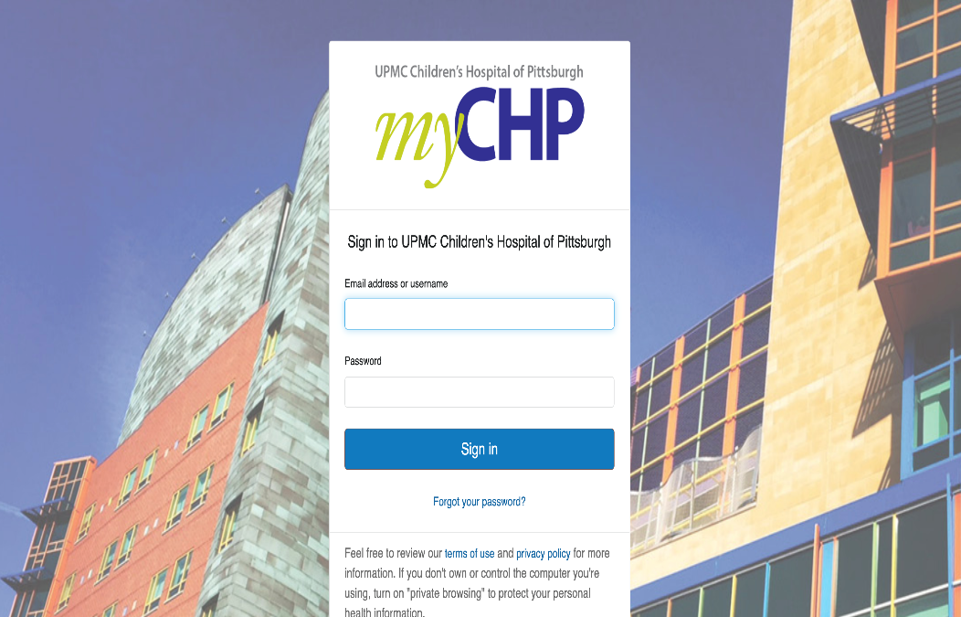
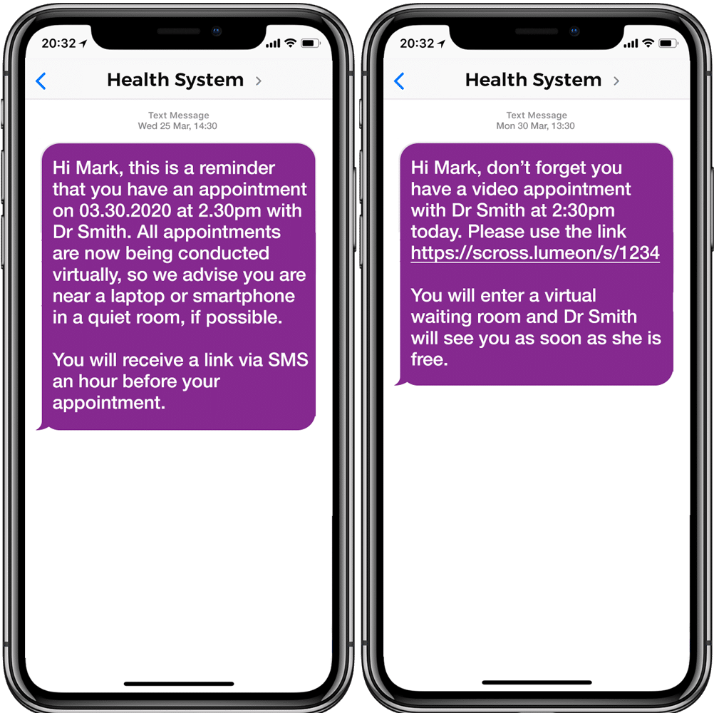
Test Your Platform:
at least 2 days before your appointment
Notes:
Testing Your Platform:
It is a good idea to be prepared
At least 2 days before your appointment. This helps you to figure out if you need help and to be prepared.
By logging into your providers portal or following the link in the email or text message that your provider sent you.
If you have not received any instructions from your provider, please call them sooner rather than later!

Slide 22
If you cannot access the platform or portal,
or do not have an email or text link
Call your Provider
at their office phone number
Don’t wait until the day of your appointment
or minutes before your appointment time to seek help!
Notes:
If you cannot access the platform or portal or do not have an email or text link Call your Provider at their office phone number
Please Don’t wait until the day of your appointment or minutes before your appointment time to seek help!
BUT, if something isn’t working that day, a call may be necessary to arrange to meet another way.
Suggestion: Find out who the technical expert is when scheduling a meeting

Slide 23

The Nuts and Bolts of Telemedicine
Your Family’s First Telemedicine
Appointment
4
Essentials For a Family-Centered Experience
Notes:
Have any of you not had a First Telemedicine Appointment yet?
Would anyone like to share how that went?

Slide 24

What does Family-Centered Telehealth mean?
a way of providing services
through a variety of digital platforms
that assures the health and well-being
of children and youth with special healthcare needs (CYSHCN) and their families through respectful family/professional partnerships
Notes:
What does Family-Centered Telehealth mean?
Family-Centered care is when you and your provider are working together for the wellbeing of your loved one.
Family-centered telehealth is a way of providing services through a variety of digital platforms that assures the health and well-being of children and youth with special healthcare needs (CYHSCN) and their families through respectful family/professional partnerships.
Family-centered telehealth can help CYSHCN and families to access health care, improve experience, reduce stress, improve communication, and improve quality of life and well-being.

Slide 25
Family Centered Telehealth Rights
Care via Telehealth
Plans of Care
You have the right to receive considerate, respectful and compassionate care through telehealth regardless of your age, gender, race, national origin, religion, sexual orientation, gender identity or disabilities.
You have the right to disagree with any plans or ask for review or changes to the plan of care in a telehealth visit just as you would during an in person visit.
Documentation
Questions
You have the right to receive the same type of information, such as test results or diagnosis, during telehealth as you would during an in person visit.
You have the right to ask your provider or the appropriate office staff any questions about logging on to, and needing assistance with, the platform.
You have the right to share information or symptoms and ask questions during a telehealth visit as you would during an in person visit.
Notes:
Everyone has certain Family Centered Telehealth Rights, similar to those you would have in a regular appointment.
Care via Telehealth
You have the right to receive considerate, respectful and compassionate care through telehealth regardless of your age, gender, race, national origin, religion, sexual orientation, gender identity or disabilities.
Plans of Care
You have the right to disagree with any plans or ask for review or changes to the plan of care in a telehealth visit just as you would during an in person visit.
Questions
You have the right to ask your provider or the appropriate office staff any questions about logging on to, and needing assistance with, the platform.
You have the right to share information or symptoms and ask questions during a telehealth visit as you would during an in person visit.
Documentation
You have the right to receive the same type of information, such as test results or diagnosis, during telehealth as you would during an in person visit.
Presenter Suggestion: Provide examples of different scenarios when discussing these “rights” so that families can understand how each one works.

Slide 26

Family Centered Telehealth Rights
Vision, Hearing & Speech
Family & Support
You have the right to accommodations for vision, hearing and speech to be able to access your telemedicine visit.
You have the right to have a family member, support person, or other individual present with you during your telehealth visit.
Interpretation
Stop a visit
You have the right to access a telehealth visit in your primary language with effective and adequate interpretation services.
You have the right to stop a telehealth visit if you feel uncomfortable at any time.
Notes:
You also have the right to
accommodations for vision, hearing and speech to be able to access your telemedicine visit.
to have someone you want present with you during your telehealth visit.
to access a telehealth visit in your primary language with effective and adequate interpretation services.
And
You have the right to stop a telehealth visit if the provider if you feel uncomfortable at any time.
Some Examples of things that may make you feel uncomfortable:
If the provider is eating, taking another call, talking with someone off camera. We will share some examples in our bloopers section of this in the bloopers section of the webinar.
Remember to ask for any needed Acoomodations or a Interpretation IN ADVANCE.
Presenter Suggestion: Share examples or scenarios of when and how to exercise these rights with communicating with a health care professional.

Slide 27
Family Centered Telehealth Responsibilities
Come with Information
Questions
Come to the telehealth visit with information and updates about your child’s health, such as celebrations in your child’s life since last visit, concerns, symptoms, treatments or hospitalizations since last visit, medications, updates from other providers, and any other information you think your providers might need to know.
Ask questions when you do not understand information or plan of care.
Take notes of any questions or concerns you have, or of any orders, plans and action items discussed during the telehealth visit.
Participation
Exam
Assist with any physical examination of your child or demonstrate issues with your child’s care, such as problem with supply or equipment, during the telehealth visit.
Actively participate in the Telehealth visit.
Offer your child the same opportunity to actively participate in the telehealth visit.
Notes:
As always, while you have rights, you also have responsibilities:
You should be prepared to:
Come with Information:
Come to the telehealth visit with information and updates about your child’s health, such as celebrations in your child’s life since last visit, concerns, symptoms, treatments or hospitalizations since last visit, medications, updates from other providers, and any other information you think your providers might need to know.
Questions:
Ask questions when you do not understand information or plan of care.
Take notes of any questions or concerns you have, or of any orders, plans and action items discussed during the telehealth visit.
Participation:
Actively participate in the Telehealth visit.
Offer your child the same opportunity to actively participate in the telehealth visit.
Exam:
Assist with any physical examination of your child or demonstrate issues with your child’s care, such as problem with supply or equipment,
during the telehealth visit.

Slide 28
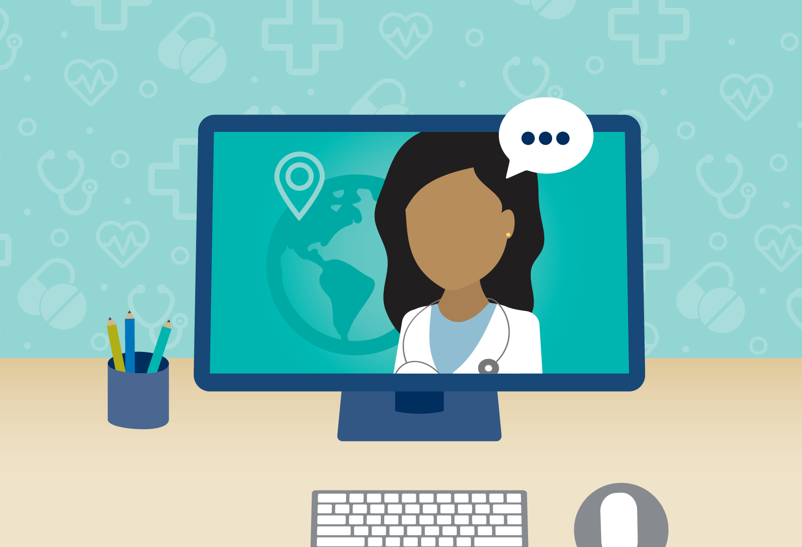
Other Names for a Telemedicine
Appointment
E- Consults
E-visits
Virtual Visits
TeleCare
TeleHealth
Virtual Care
mHealth
Virtual Health Care
On-line Visit
Video Visit
Phone Visit
Notes:
You’ll remember that I said that this can be confusing.
One part of the confusion is that there areOther Names for a Telemedicine Appointment
f your provider calls it something else, I want you to recognize the name.
E- Consults
E-visits
Virtual Visits
TeleCare
TeleHealth
Virtual Care
mHealth
Virtual Health Care
On-line Visit
Video Visit
Phone Visit
These are just some of the names for a Telemedicine Appointment.
There may be terms that are not on this list that your provider calls their appointments, so be sure to ask your provider for clarification if you have any questions.

Slide 29
Before the Visit
Space
Equipment
Information
Participants
Reduced Noise Environment
Confidential
Internet Connected
Well Lit
Tele-Ready Device
Platform/Portal
Pen/Paper
Other Medical Equipment
(scale, flashlight)
Celebrations
Observations
Medication List
Provider Updates
Prepare your child, young adult and any attendees
(what to expect, social story, questions)
Notes:
To be prepared for your visit there are some things you need to consider:
WHERE will you have this visit?
(Space)
What do you need for the visit?
(Equipment)
What do you need to provide the provider?
(information)
Who will be involved?
(Participants)

Slide 30
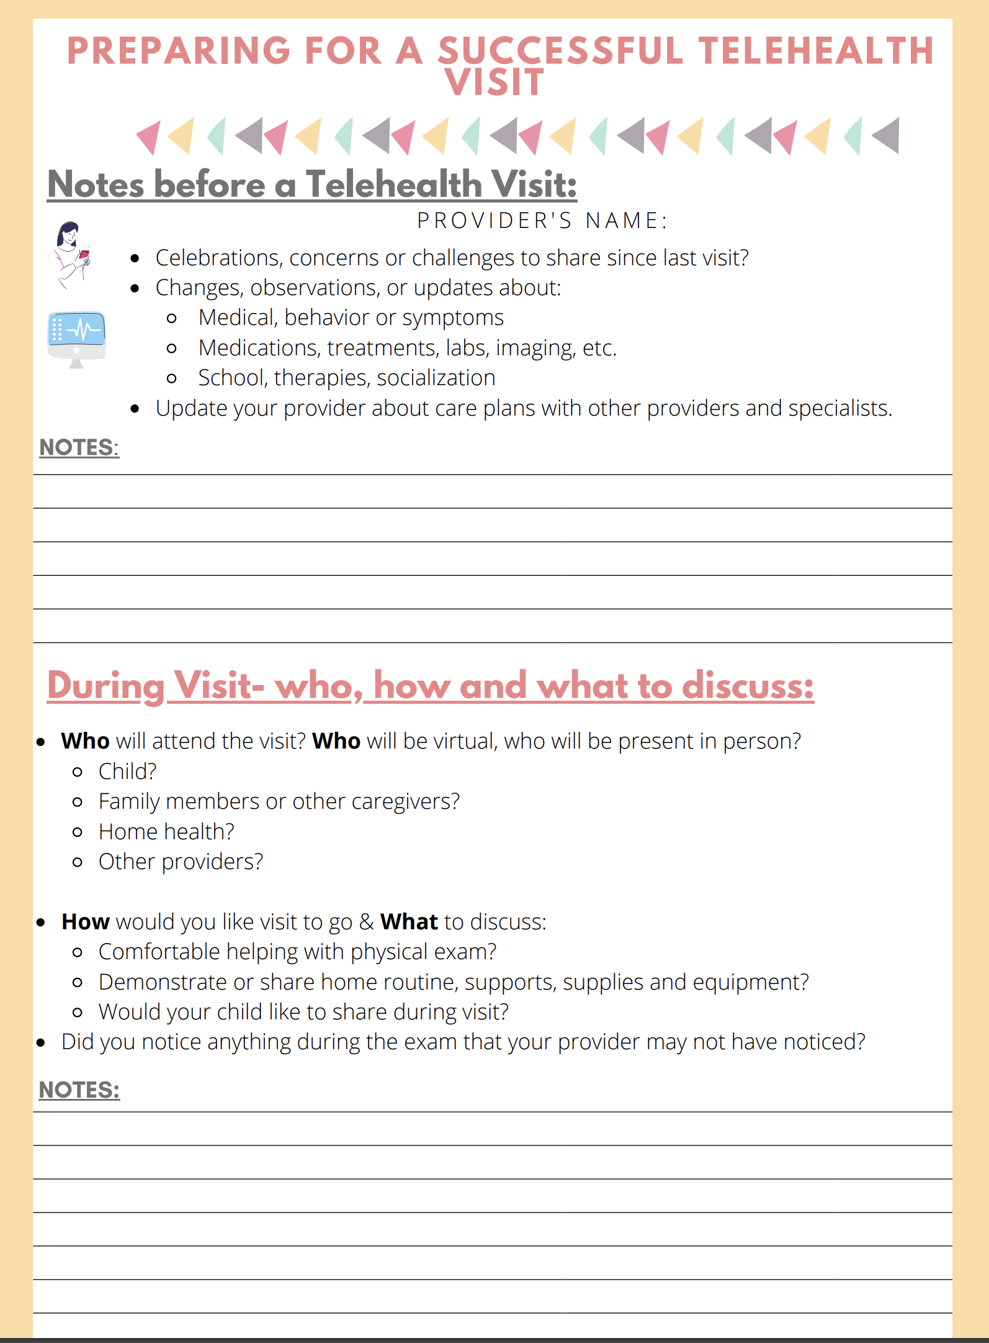
Before The Visit:
Information
Utilizing a tool like this
Family Voices Worksheet
can help you prepare!
Notes:
It is important to gather BEFORE THE VISIT.
Using a tool like this Family Voices Worksheet for preparing for a successful telehealth visit can help you prepare!
SHARE IN CHAT

Slide 31
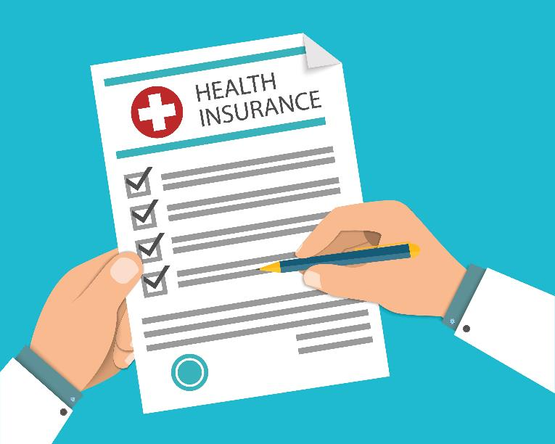
Insurance
Insurance coverage for telehealth is impacted by federal and state laws as well as insurance company policies.
Telehealth policy changes occurring within the COVID-19 environment have been rapidly developing on almost a daily basis.
Notes:
Insurance coverage for telehealth depends on federal and state laws as well as insurance company policies.
Telehealth policy changes occurring within the COVID-19 environment have been changing a lot.
Because of the frequent changes, we can’t give a one size fits all answer to the question about whether you will have to pay for your telemedicine appointment.
But there are some things you can do…
Check with any insurance company that you use and do ask your provider. While your provider will. To know about all insurances, if you use public insurance, they will be aware of coverage.

Slide 32
Ways to Schedule
the Appointment
When you Schedule
the Appointment
Call provider- schedule by phone
Login to the Portal- schedule online
Provider/Practice’s Website- schedule online
Fill out intake form- they call you
Central Scheduling Number- by phone
Specialist changes your yearly appointment to a telemedicine appt.- phone or online notification
Assure your provider has your most current phone number or email.
If you are speaking to someone at the office:
  ASK: How long is visit going to be?
  ASK: Do any forms need updated?
  ASK: How do I ‘see’ my provider on the day of the appointment? Link? Login? Portal?
  Request an Interpreter (if needed) or any other accommodations needed*
*Accommodations should be requested when making the appointment and confirmed BEFORE the VISIT begins.
Notes:
When you need to schedule your telemedicine appointment there are some considerations.
Calling your provider on the phone is only one of the many ways telemedicine appointments may be scheduled in today’s world, some other options include:
Login to the Portal- schedule online
Provider/Practice’s Website- schedule online
Fill out intake form- they call you
Central Scheduling Number- by phone
Specialist changes your yearly appointment to a telemedicine appt.- phone or online notification
When scheduling your appointment-
It is important to assure your provider has your most current phone number or email.
If you are speaking on the phone with someone in your provider’s office:
ASK: How long is visit going to be?
ASK: Do any forms need updated?
ASK: How do I ‘see’ my provider on the day of the appointment? Link? Login? Portal?
ASK: Can I request an Interpreter(if needed)? Or any other Accommodations needed?
It is CRUCIAL that any accommodations are requested when making the appointment and confirmed BEFORE the APPOINTMENT.

Slide 33
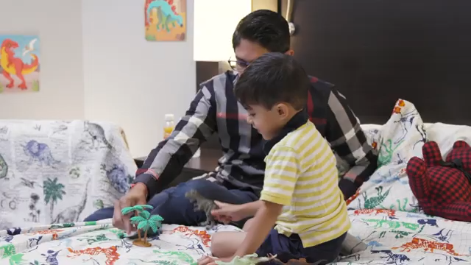
During The Visit
You may be asked to:
Take your child's vital signs like blood pressure or temperature
Gently push on your child's stomach as instructed by the provider
Perform other procedures, as requested
Hold your phone or computer camera to areas on your child's body so your provider can do a thorough examination
Notes:
During The Visit
You may be asked to:
Take your child's vital signs like blood pressure or (explain that you may not need to do this, if you need this equipment and do not have it check with provider)
temperature
Gently push on your child's stomach as instructed by the provider
Perform other procedures, as requested
Hold your phone or computer camera to areas on your child's body so your provider can do a thorough examination
Presenter Suggestions: You may want to share that there are also religious/cultural challenges and families have a right to disclose cultural or religious restrictions that would impact their ability to provide access to the child’s body.
Share that if the doctor is using a secure platform, then your information will be secure.
As you can see from the video- the dad pressing on his son’s stomach where the bandages were
And the mom helping move her child’s wrist for the provider

Slide 34
Tips for During Visit
Younger Ones:
Provide a snack or meal before the visit
Avoid scheduling appointment at nap time
Comfortable Location
Have their favorite toy available
Have a snack/drink available
Older Ones:
Eat before your appt
Find a comfortable location (your room, couch)
What is your comfortable environment (hat over face)
Have water/drink nearby
Notes:
Since a telemedicine appointment is different from actually GOING to an appointment, here are some ideas that you many Ot have thought about for helping Kids and Teens During the visit:
Younger Ones
Provide a snack or meal before the visit
Avoid scheduling appointment at nap time
Comfortable Location
Have their favorite toy available
Have a snack/drink available
Older Ones:
Eat before your appt
Find a comfortable location (your room)
What is your comfortable environment (hat over face)
Have water/drink nearby

Slide 35
Next Steps Tips
At the end of your visit, you and your healthcare provider should discuss diagnosis and treatment plan.
PAUSE and make sure you understand and are comfortable with the plan.
Any questions? Does the plan meet the needs of your family?
Schedule any future follow-up appointments/testing/labs
Who is taking care of orders and prescriptions
What referrals might be needed and who is making them.
Plan visit for little longer/shorter for next time and communicate what
accommodations could be made for next visit.
If you have any questions or concerns after your visit has ended, contact your health care provider's office.
Notes:
At the end of your visit, you and your healthcare provider can: Discuss diagnosis and treatment plan.
PAUSE and make sure you understand and are comfortable with the plan.
Any questions? Does the plan meet the needs of your family?
Schedule any future follow-up appointments and any needed testing or labs
Discuss who is taking care of orders and prescriptions
Discuss what referrals might be needed for further care, support or to other providers and who is making them.
Plan visit for little longer/shorter for next time and communicate what accommodations could be made for next visit.
After The Visit Tip
Once you hang up the phone or disconnect from the computer or device, we are in the AFTER the VISIT section.
If you have any questions or concerns after your visit has ended, contact your health care provider's office.

Slide 36

The Nuts & Bolts of Telemedicine
You can get connected!
You have a device!
You have ways to see your provider and are prepared for your visit!
You know what to do!
Notes:
We have talked about connections, ways to get connected and troubleshooting problems.
We hope you have a more comprehensive understanding of different types of devices that can be used for Telemedicine visits
We have explored the actual visit with you and your rights and responsibilities.
We hope that we have helped you to expand your understanding of telemedicine and prepared you to take your own next stepss.
If we can be of additional help with any healthcare or educational issue regarding your child, please do not hesitate to call us.

Slide 37

Please take a minute and fill out this brief Evaluation!
https://redcap.link/FVCurriculum_EN
Notes:
Last, but not least, please complete this evaluation to help our finders continue to improve their work in helping you.

Slide 38


Thank you!
Contact us at PEAL if you have any questions
or need more information or assistance!
info@pealcenter.org
1-866-950-1040
Notes:
Once again, we are here for you.
Thanks for coming!

