Slide 1



Los Aspectos Principales
de la Telemedicina:
Información Esencial para una Experiencia Centrada en la Familia
Notes:
Welcome to The Nuts and Bolts of Telemedicine: Essentials for a Family-Centered Experience

Slide 2

Este programa cuenta con el apoyo de la Administración de Recursos y Servicios de Salud (HRSA) del Departamento de Salud y Servicios Humanos de los EE. UU. (HHS) como parte de un premio por un total de $1,000,000 con un 0% financiado con fuentes no gubernamentales. El contenido pertenece a los autores y no representan necesariamente las opiniones oficiales ni el respaldo de HRSA, HHS o el gobierno de los EE. UU. Para obtener más información, visite HRSA.gov
Notes:
First we would like to start off with a statement from our funders,
“This program is supported by the Health Resources and Services Administration (HRSA) of the U.S. Department of Health and Human Services (HHS) as part of an award totaling $1,000.000 with 0% financed with non-governmental sources. The contents are those of the authors and do not necessarily represent the official views of, nor an endorsement, by HRSA, HHS, or the U.S. Government. For more information, please visit HRSA.gov.”

Slide 3
Los Participantes podrán:
Identificar opciones para conectarse y participar en una cita de Telesalud.
Determinar qué dispositivos se pueden usar para asistir a una cita de Telesalud.
Entender la diferencia entre las plataformas y los portales usados para la Telemedicina.
Explicar qué se necesita hacer antes, durante y después de su visita de Telesalud.
Objetivos de
la Presentación

Slide 4
¿A qué nos referimos cuando decimos...
Telemedicina | Telesalud
A menudo se usa indistintamente para referirse a la “telesalud” Se enfoca en el aspecto clínico del cuidado una cita en video con el pediatra de su niño una sesión de terapia virtual con el terapista del lenguaje de su joven adulto | Utilizando tecnologías de información y comunicación electrónicas, tales como: Video chat Internet Wifi para apoyar cosas como: cuidado de salud a larga distancia educación relacionada con la salud salud pública administración de la salud

Slide 5

Otros Nombres para una Cita de Telemedicina
Consultas Electrónicas (E-Consults)
Visitas Electrónicas
(E-visits)
Visitas Virtuales
TeleCuidado
TeleSalud
Cuidado Virtual
Salud Móvil (mHealth)
Cuidado de Salud Virtual
Visita en Línea
Visita por Video
Visita por Teléfono
Notes:
There may be terms that are not on this list that your provider calls their appointments, so be sure to ask your provider for clarification if you have any questions.

Slide 6
Los Aspectos Principales
de la Telemedicina
¿Está usted
Conectado?
1
Información Esencial para una Experiencia Centrada en la Familia
Notes:
Welcome to the Family Voices Series: The Nuts and Bolts of Telemedicine. This is a four-part webinar series and today we will be talking about “Are you connected?”.
In the first webinar in this series we will discuss some things that will be essential for family-centered telemedicine experience.
Let’s get start…

Slide 7
¿Qué significa "estar conectado"?
La habilidad de enviar y recibir información a través del ciberespacio
  Llamadas telefónicas
  Mensajes de texto
  Correos electrónicos
  Publicar fotos en las redes sociales
  Video chats
Conexiones celulares/móviles comparados con el Internet/de banda ancha
Notes:
Data can be a lot of different things; for instances you could make a phone call, and your voice is data being transmitted on phone lines or through a mobile service through the air. You can send text messages and that is data. The letters that make words are data. That can be represented by two (2) dots because it takes a little bit more data to send a text message. Then we might send an email like we used in our example of our houses and that might take a little bit more data so maybe it is represented by four (4) of these data dots. And then, say we would like to post a photo on social media that takes quite a bit more data because a photo has a lot of data embedded in it to make up the picture so here’s a little pile of dots to represent the photo data.
Then we come to a video call or telemedicine appointment with your child’s doctor. You can see this takes a lot of data with a large pile of orange dots; because it involves not only my voice but also video, possibly pictures and so it takes quite a bit more data.

Slide 8
Algunas Opciones para Conectarse en su Comunidad
si no está Conectado en Casa
El Programa
Lifeline
Cafetería
Un Lugar
De reunión
(Chapter House,
General Store)
Centro
Comunitario
Restaurantes
De Comida Rápida
La Oficina de
Family Voices
(u otro proveedor
comunitario)
Centro
Cultural
Biblioteca
Escuela
Notes:
Let’s talk about some options for getting connected in your community if you do not have access to a connection at your home.
Community center: one option would be to drive or visit a community center near your location that might have wireless internet.
Many fast food restaurants offer Wi-Fi with the purchase of a meal or food so that can be a place to access internet as well.
Cultural liaison Hub or Cultural Center these might also be places to find access.
Almost all libraries have access to Internet and some even have private rooms that you could reserve to have a quiet spot away from those who are reading and studying.
A Gathering Place in your community such as a chapter house or a general store might also be places with active hotspots or allow their visitors to access the internet.
Family Voices Offices or other community providers might be a place where you can get assistance with getting connected. We already mentioned coffee shops as well and also as you probably know our schools offer a place to connect when school is in session.
“Lifeline” is not a physical place to connect to the internet but it is a means to help finance and pay for internet services if that is a concern for your family and a barrier for you not being able to have internet at your home or at another place. Lifeline is a federal program and we have some more information and resources on how to access that.
Suggestion – Share with audience that some internet and cellphone providers are offering hotspots free of charge, throughout many states.

Slide 9
Los Aspectos Principales de la Telemedicina
¿Tiene un dispositivo?
2
Información Esencial para una Experiencia Centrada en la Familia

Slide 10




Categorías y Ejemplos
de Dispositivos
Computadoras
Computadora Portátil (Laptop)
Computadora de Escritorio
Chromebook
Tabletas
iPad
Kindle Fire
Microsoft Surface
Telefóno Inteligente
Android
iPhone
Galaxy
Notes:
There are 3 main categories for Devices that we will dive into more detail about today: Computers, Tablets and Smart Phones.

Slide 11
Los Aspectos Principales
de la Telemedicina
¿Puede "ver" a su proveedor?
3
Información Esencial para una Experiencia Centrada en la Familia

Slide 12
¿Cómo “veo” a mi proveedor?
Para ver a su proveedor para una cita de telemedicina, necesitará un software.
Este software a menudo se denomina plataforma a la que se puede acceder a través de un portal, para que pueda ver a su proveedor y para que su proveedor pueda verlo a usted.
La mayoría de las veces, el Proveedor elegirá la forma en que usted los “verá” eligiendo qué plataforma/portal utiliza su práctica para sus citas de telemedicina.
Plataforma | Portal
Un sistema de software de telesalud seguro que permite que un proveedor y un paciente tengan una interacción de video bidireccional segura para una visita virtual | Un sitio web o página web que proporciona acceso o enlaces a otros sitios.
Notes:
In today’s webinar we are going to discuss SOFTWARE, specifically portals and platforms..
To see your provider for a telemedicine appointment, you will need software. This software is often called a platform which may be accessed through a portal, so you can see your provider and so your provider can see you.
What exactly is a portal and a platform?
Example- the zoom software that allows you to have a video interaction for your appointment.
Portal-
A website or web page providing access or links to other sites. In healthcare settings, it may include access to electronic medical records, messaging your doctor, online appointment scheduling and access to telehealth appointments
Example: MyChart at your children’s hospital for specialist visit
Since the Provider chooses the way you will “see” them by picking which platform their practice uses for their telemedicine appointments, again if you are unsure of which platform your provider uses, Contact your Provider… ahead of appointment to ask.

Slide 13









Ejemplos de Plataformas y Portales
Amwell
Microsoft Teams
Skype
Portal del Hospital
eVisit
VSee
Zoom
Doxy.me
MyChart
Puede que tenga que utilizar diferentes métodos para ver a varios
proveedores para citas de telemedicina.
Por ejemplo, el pediatra de su hijo puede usar zoom y su
cardiólogo pediátrico puede utilizar el portal del hospital.
Notes:
The words Portal/Platform and Website/App/Software
are sometimes used interchangeably to mean the way you as a patient can see your provider for a telemedicine appointment.
There are over 150+ possible ways or platforms out there to see your provider.
We are going to pick a few common platform to describe.
If you are unsure of which platform your provider uses, Contact your Provider… ahead of appointment to ask.

Slide 14




Así como para una cita en persona, debe ingresar a la sala de observación para ver a su médico, aquí también tendrá que abrir la "Puerta" de la Sala de Observación Virtual para "ver" a su médico.
El Doctor está Atendiendo
Notes:
Just as you have to enter the exam room to see your doctor in person … we also have to open an electronic door to see our providers for a telemedicine appointment.

Slide 15

4 Claves
Correo electrónico
Texto
Acceso
Llame a su Proveedor
Las visitas en persona no requieren de una llave real para abrir la puerta de la sala de observaciones, pero para una visita virtual o de telemedicina, se necesitará una “llave” para proteger su identidad y para los propósitos de seguridad y confidencialidad.
Notes:
The 4 keys to open the virtual door to ”see your provider” are:
Email, Text, Log-In, and to Call your provider.
While you may not need a real metal key to open an exam room door for your in-person visit, in order to protect your identity and for your security and confidentiality, you will need one of these virtual “keys” to access your telehealth visit.
Let’s dig a bit deeper into understanding how each of these keys works to open this virtual exam room door.

Slide 16



Palabras Claves para el Acceso
Nombre de Usuario
Sitio Web/Página Web
Contraseña
Una página web es una colección específica de información proporcionada por un sitio web y que se le muestra en un navegador web. Imagine que las páginas web son las páginas de un libro y el sitio web es el libro.
Software
El software puede ser los programas, aplicaciones (apps) e instrucciones de funcionamiento para la computadora (o hardware).
Apps
Apps es la forma abreviada para "aplicación", que es lo mismo que un programa de software. Se utiliza con mayor frecuencia para describir programas para dispositivos móviles, como teléfonos inteligentes y
tabletas.
Notes:
Login Words to Know
Username, Login, and Password were all reviewed when we talked about emails. Similarly these words mean essentially the same thing but now instead of accessing your email account you will be using a username and password to login to a portal.
Website/Webpage
A webpage is a specific collection of information provided by a website and displayed to you in a web browser. Webpages can be thought of pages in a book and the website is the book
Software
Software can be the programs, applications or apps, and operating instructions for the computer(or hardware).
Apps
short for "application," which is the same thing as a software program. It is most often used to describe programs for mobile devices, such as smartphones and tablets.
Suggestion: Give examples of each of these. Use examples that are familiar to participants. You may want to ask audience to share examples that they are aware of to increase engagement. You can use a poll in Zoom to test their knowledge on these. Also, if you want to customize slides, you can use other pictures to represent each of the words.

Slide 17
Unas Palabras Acerca de HIPAA
Ley de Responsabilidad y Portabilidad del Seguro de Salud
HIPAA es la ley acerca de la información de salud.
HIPAA crea reglas sobre las formas en que la información de salud privada y protegida (a veces llamada “PHI”) puede ser compartida, almacenada y utilizada por cualquier persona que no sea la persona a quien se refiere.
La mayor parte de su información médica está protegida por HIPAA, incluida toda la información personal que podría usarse para identificarlo, como: su historial médico anterior, su estado de salud o su información de pago.
HIPAA no protege la información de salud que no se vincula explícitamente con usted. Esto significa que cualquier dato de salud que sea más o menos anónimo se puede agregar a las bases de datos médicas.
Notes:
HIPAA stands for Health Insurance Portability and Accountability Act
The Health Insurance Portability and Accountability Act, usually called “HIPAA,” is a law about information. HIPAA creates rules about the ways that private health information (sometimes called “PHI”) can be shared, stored and used by anyone other than the person it is about. Most of your health information is protected under HIPAA, including all personal information that could be used to identify you, like your previous health history, health status, or payment information. However, HIPAA doesn’t protect the health information that doesn’t explicitly link to you. This means that any health data that is more or less anonymous can be added to medical databases.

Slide 18
Durante una Emergencia de Salud Pública (PHE)
Durante la PHE, los proveedores podrán utilizar plataformas que pueda que no cumplan con HIPAA, si se hiciera de buena fe, y el público no tuviera acceso a la plataforma.
Entonces, durante una emergencia de salud pública, un proveedor podría usar una plataforma como FaceTime, Facebook Messenger, Skype (tradicional), etc.
Sin embargo, no pueden usar productos como Twitch, Facebook Live, TikTok, YouTube, etc.
HIPAA
Notes:
During the Public Health Emergency, providers can use non-HIPAA compliant platforms, as long as it is done so in good faith, and the platform is non-public facing. So they can use anything like FaceTime, Facebook Messenger, Skype (traditional), etc. They cannot use products like Twitch, Facebook Live, TikTok, YouTube, etc.
Suggestion: Mention that these apps are not sharing your health information with anyone else.

Slide 19

La Mayoría de las Plataformas incluyen:
Llamadas de Video
Video Chat
Pantalla Compartida
Cumplimiento de las Normas de HIPAA
Otras tareas que puede hacer en el Portal:
Programe una Cita
Darle Acceso a una Familia a la información médica de su niño
Enviar Mensajes a su Proveedor
Pagar su Cuenta
Ver la Lista de Medicamentos
Ver el Perfil de Salud
Obtener Instrucciones
Encontrar a un Doctor en el
sistema
Notes:
Most Platforms include:
Video Calls
Video Chat
Shared Screen – Suggestion: Explain shared screen for audience and give example
HIPAA Compliance
Other tasks you can do in a Portal:
Schedule an appointment
Give a family access to their child’s medical records
Message your provider
Pay Your Bill
View List of Medications
View Health Profile
Get Directions
Find a Doctor in the system

Slide 20
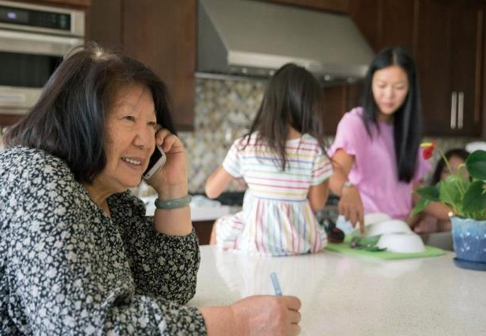
Historias Familiares
Una abuela estaba intentando programar una visita para su nieta. El consultorio del pediatra le dice que pueden verla con una cita de telemedicina.
La Abuela: "¿Cómo puedo hacer eso?”
La Oficina del Pediatra: Recibirá un correo electrónico 24 horas antes de su visita.
La Abuela: Cuelga y se dice a si misma,
“Me siento insegura”. Ella vuelve a llamar a la oficina: "¿Podríamos hacerlo por teléfono?”
La Oficina del Pediatra: ¡Sí! El médico la puede llamar en vez de hacer una videollamada. “Ahh!” La abuela se sintió aliviada.
Hablemos de la experiencia de una familia con "ver" a su proveedor ...
Notes:
Let’s talk about A Family Experience with ‘Seeing’ their Provider…
A grandmother was attempting to schedule a visit for her granddaughter. When she called, they said that the provider could see her through telehealth. The grandmother asked how she would access the appointment because she was unsure. The doctor’s office told her that an email link would be sent to her 24 hours prior to the visit. The grandmother got off of the call and felt unsure of what to do or how to see her granddaughter’s provider. She called back to the office and said that she was not comfortable doing it on the computer and asked was there any way to complete the visit by phone. The doctor’s office said that the doctor could call her instead of doing a video call. The grandmother felt relieved and was able to participate in her granddaughter’s appointment
Engagement suggestion: Have a live scenario and have the audience participate with roll playing. You could do break rooms if using Zoom.

Slide 21







¿Quién puede ayudar?
Llame al Proveedor y elija la opción para hablar con la enfermera.
Comuníquese con su Proveedor/ Personal para pedir que lo guien.
Pregúntele al Proveedor si lo pueden ver en su oficina usando su equipo, donde alguien lo pueda ayudar (Pueda que el Proveedor esté en una ubicación diferente)
Pregúntele a un
Adolescente
Personas en su Lugar
de Culto
Personal de la
Biblioteca
El Personal de PEAL
Un Vecino
Llame a un Amigo
En Su Comunidad
Notes:
Alternatives to Seeing Providers/ accessing platform: # 1 Call your Provider. #2 Seek help in your community
Someone from practice called and walked through what to expect
Wanting to do an appt via telemedicine but that is not available, referred to urgent care/ER, resorted to insurance telemedicine
Patient going to the clinic and doctor is on video,
4. Just note that you may be seeing your provider- your location or your providers may be different depending on the situation- location/hub.
5. Policy stuff- there are a lot of things in place right now… for COVID that may or may not remain in place
6. Calling the nurse line/advice line for the clinic (pick the option to speak with someone NOW) to let them know if your platform is working.
7. When person can’t do links/technology… reach out to the provider to do by phone
8. Asking about in-person options/comfort level
9. Looking on online tutorials /you can learn anything on YouTube
10. Neighborhood/ reach out to community
11. Advocate for multigenerational inclusion
12. Ask your teenager!
13. Phone a Friend
Suggestion: Remind families that pressing 0 may not always be the best option. Best practice is to listen to all the prompts to avoid being placed back in their cue or listening to the message over again

Slide 22



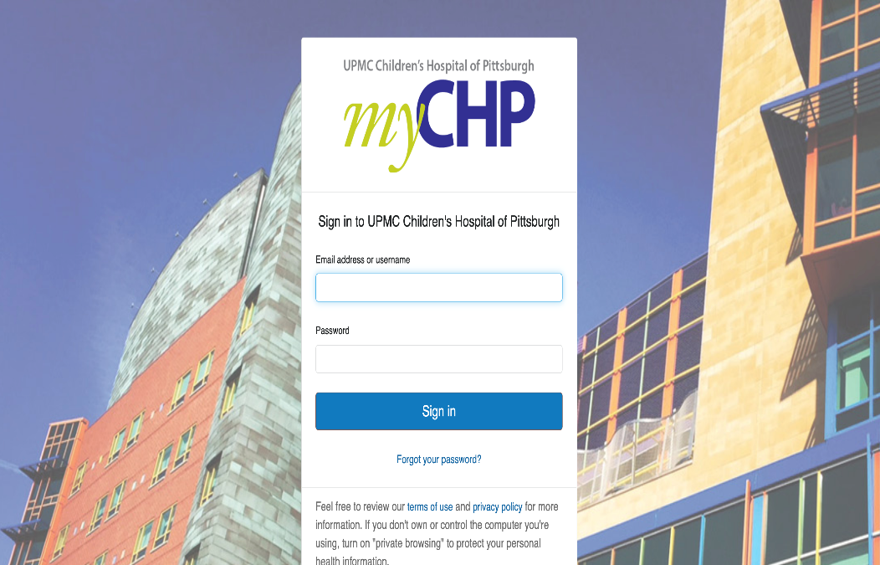
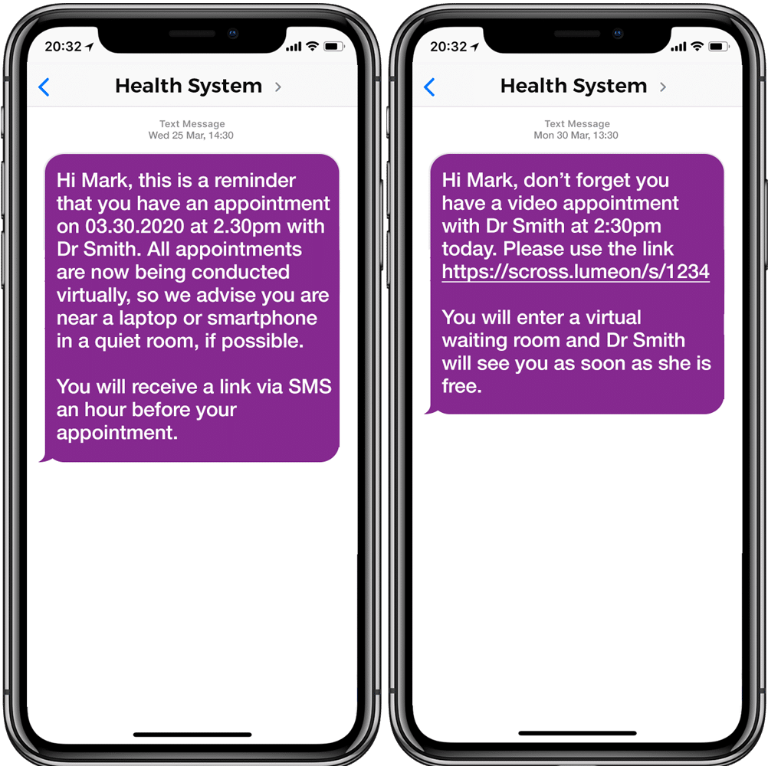
Examine Su Plataforma:
por lo menos 2 días antes de su Cita
Notes:
Testing Your Platform:
At least 2 days before your appointment
By logging into your providers portal or following the link in the email or text message that your provider sent you.
If you have not received any instructions from your provider, please call them sooner rather than later!

Slide 23

Si no pudiera acceder a la plataforma o el portal,
o no tuviera un enlace via correo electrónico o texto
Llame a su Proveedor
Al número de la oficina
¡No espere hasta el día de su cita o minutos antes de la hora de su cita para buscar ayuda!
Notes:
If you cannot access the platform or portal or do not have an email or text link Call your Provider at their office phone number
Please Don’t wait until the day of your appointment or minutes before your appointment time to seek help!
Suggestion: Find out who the technical expert is when scheduling a meeting

Slide 24

Los Aspectos Principales
de la Telemedicina
La Primera Cita de Telemedicina de su Familia
4
Información Esencial para una Experiencia Centrada en la Familia
Notes:
Welcome to Webinar #4 in the Family Voices series: The Nuts and Bolts of Telemedicine. Today we will be discussing, ”Your Family’s First Telemedicine Appointment” and further exploring the essentials for a family-centered telemedicine experience. Let’s get started…

Slide 25

¿Qué significa la Telesalud Centrada en la Familia?
una forma de prestar servicios
a través de una variedad de plataformas digitales
que asegura la salud y el bienestar
de niños y jóvenes con necesidades especiales de salud (CYSHCN) y sus familias mediante asociaciones respetuosas entre las familias y los profesionales
Notes:
What does Family-Centered Telehealth mean?
Family-Centered care is when you and your provider are working together for the wellbeing of your loved one.
Family-centered telehealth is a way of providing services through a variety of digital platforms that assures the health and well-being of children and youth with special healthcare needs (CYHSCN) and their families through respectful family/professional partnerships.
Family-centered telehealth can help CYSHCN and families to access health care, improve experience, reduce stress, improve communication, and improve quality of life and well-being.

Slide 26




Telesalud Centrada en la Familia
Derechos
Cuidado via Telesalud
Planes de Cuidado
Preguntas
Documentación
Visión, Audición y Lenguaje
Familia y Apoyo
Interpretación
Ponga un alto a la Visita
Responsabilidades
Viene con Información
Preguntas
Participación
Examen
Notes:
Family Centered Telehealth Rights and Responsibilities
More Information is on the handout provided
Care via Telehealth
You have the right to receive considerate, respectful and compassionate care through telehealth regardless of your age, gender, race, national origin, religion, sexual orientation, gender identity or disabilities.
Plans of Care
You have the right to disagree with any plans or ask for review or changes to the plan of care in a telehealth visit just as you would during an in person visit.
Questions
You have the right to ask your provider or the appropriate office staff any questions about logging on to, and needing assistance with, the platform.
You have the right to share information or symptoms and ask questions during a telehealth visit as you would during an in person visit.
Documentation
You have the right to receive the same type of information, such as test results or diagnosis, during telehealth as you would during an in person visit.
Presenter Suggestion: Provide examples of different scenarios when discussing these “rights” so that families can understand how each one works.
Vision, Hearing & Speech
You have the right to accommodations for vision, hearing and speech to be able to access your telemedicine visit.
Family & Support
You have the right to have a family member, support person, or other individual present with you during your telehealth visit.
Interpretation
You have the right to access a telehealth visit in your primary language with effective and adequate interpretation services.
Stop a visit
You have the right to stop a telehealth visit if the provider if you feel uncomfortable at any time.
Some Examples of things that may make you feel uncomfortable:
If the provider is eating, taking another call, talking with someone off camera. We will share some examples in our bloopers section of this in the bloopers section of the webinar.
Presenter Suggestion: Share examples or scenarios of when and how to exercise these rights with communicating with a health care professional.
Family Centered Telehealth Responsibilities:
As patients and caregivers we have rights during a telemedicine appointment, we also have responsibilities. Let’s discuss some of those now:
Come with Information:
Come to the telehealth visit with information and updates about your child’s health, such as celebrations in your child’s life since last visit, concerns, symptoms, treatments or hospitalizations since last visit, medications, updates from other providers, and any other information you think your providers might need to know.
Questions:
Ask questions when you do not understand information or plan of care.
Take notes of any questions or concerns you have, or of any orders, plans and action items discussed during the telehealth visit.
Participation:
Actively participate in the Telehealth visit.
Offer your child the same opportunity to actively participate in the telehealth visit.
Exam:
Assist with any physical examination of your child or demonstrate issues with your child’s care, such as problem with supply or equipment,
during the telehealth visit.

Slide 27
Antes de la Visita
Espacio
Equipo
Información
Participantes
Reducir el Ruido
Entorno
Confidencial
Conectado al Internet
Bien iluminado
Dispositivo-Tele listo
Plataforma/Portal
Lapicero/Papel
Otro Equipo Médico (balanza, linterna)
Celebraciones
Observaciones
Lista de Medicamentos
Actualizaciones del Proveedor
Prepare a su niño, adulto joven y a cualquier otra persona asistente
(qué se debe esperar, historia social, preguntas)

Slide 28
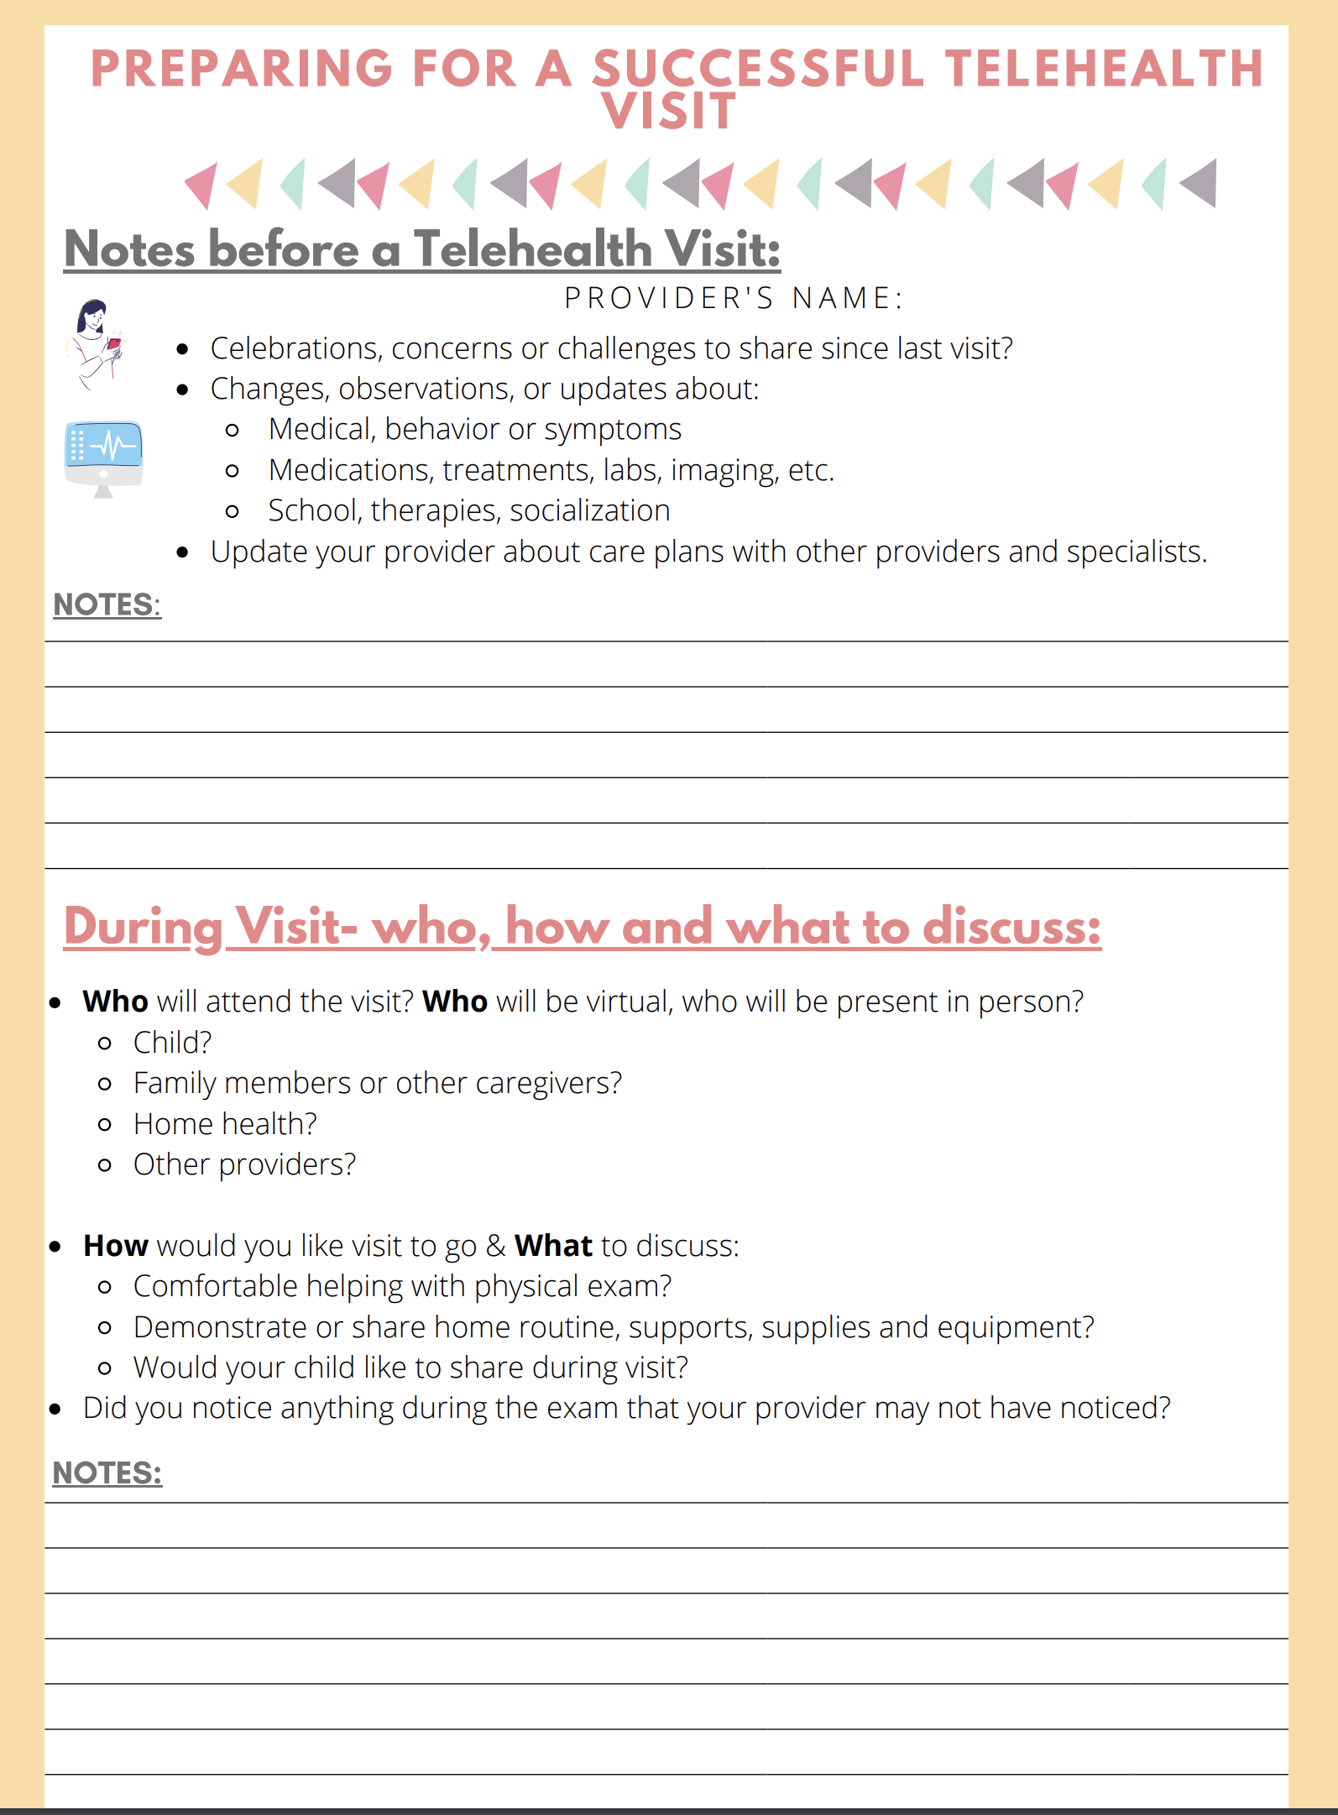

Información
Antes de la Visita:
¡Utilizando una herramienta
como esta
Hoja de Trabajo de Family Voices
puede ayudarlo a prepararse!
Notes:
The third thing we need to gather BEFORE OUR VISIT includes: Information
Utilizing a tool like this
Family Voices Worksheet for preparing for a successful telehealth visit
can help you prepare!

Slide 29
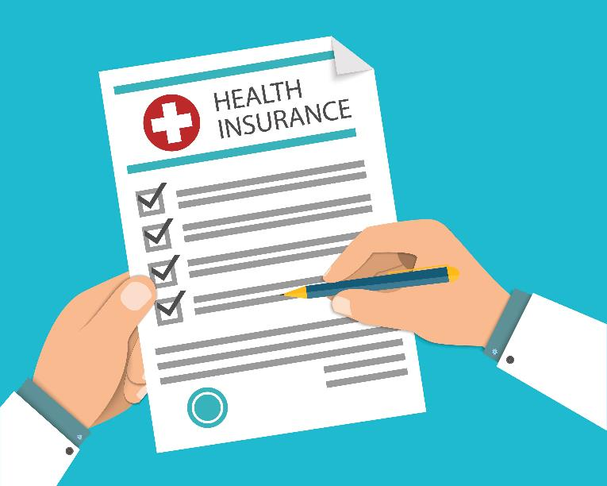
Seguro Médico
La cobertura del seguro para la telesalud se rige por las leyes federales y estatales, así como por las pólizas de las compañías de seguros.
Los cambios en las políticas de telesalud que ocurren dentro del entorno dle COVID-19 se han desarrollado rápidamente casi a diario.
Notes:
Insurance coverage for telehealth is impacted by federal and state laws as well as insurance company policies.
Telehealth policy changes occurring within the COVID-19 environment have been rapidly developing on almost a daily basis.
This precludes us from giving a one size fits all answer to the question about whether you will have to pay for your telemedicine appointment.
But here are some things you can do…

Slide 30
Formas de Programar
la Cita
Llame al proveedor: programe por teléfono
Inicie sesión en el Portal: programe en línea
Sitio web del proveedor o del consultorio: programación en línea
Complete el formulario de admisión, lo llamarán
Número de programación central: por teléfono
El especialista cambia su cita anual a una cita de telemedicina - notificación por teléfono o en línea
Notes:
Now it’s time to schedule your telemedicine appointment.
Calling your provider on the phone is only one of the many ways telemedicine appointments may be scheduled in today’s world, some other options include:
Login to the Portal- schedule online
Provider/Practice’s Website- schedule online
Fill out intake form- they call you
Central Scheduling Number- by phone
Specialist changes your yearly appointment to a telemedicine appt.- phone or online notification
When scheduling your appointment-
It is important to assure your provider has your most current phone number or email.
If you are speaking on the phone with someone in your provider’s office:
ASK: How long is visit going to be?
ASK: Do any forms need updated?
ASK: How do I ‘see’ my provider on the day of the appointment? Link? Login? Portal?
ASK: Can I request an Interpreter(if needed)? Or any other Accommodations needed?
It is CRUCIAL that any accommodations are requested when making the appointment and confirmed BEFORE the APPOINTMENT.

Slide 31
Cuando Programe
la Cita
Asegúrese de que su proveedor tenga su número de teléfono o su correo electrónico más actualizado.
Si está hablando con alguien en la oficina:
  PREGUNTE: ¿Cuánto tiempo va a durar la visita?
  PREGUNTE : ¿Es necesario actualizar algún formulario?
  PREGUNTE : ¿Cómo ‘veo’ a mi proveedor el día de la cita? ¿Enlace? ¿Acceso? ¿Portal?
  Solicite un Intérprete (si fuera necesario) o cualquier otra acomodación necesaria *
*Las acomodaciones deberán solicitarse al hacer la cita y confirmarse ANTES de que comience la VISITA.
Notes:
Now it’s time to schedule your telemedicine appointment.
Calling your provider on the phone is only one of the many ways telemedicine appointments may be scheduled in today’s world, some other options include:
Login to the Portal- schedule online
Provider/Practice’s Website- schedule online
Fill out intake form- they call you
Central Scheduling Number- by phone
Specialist changes your yearly appointment to a telemedicine appt.- phone or online notification
When scheduling your appointment-
It is important to assure your provider has your most current phone number or email.
If you are speaking on the phone with someone in your provider’s office:
ASK: How long is visit going to be?
ASK: Do any forms need updated?
ASK: How do I ‘see’ my provider on the day of the appointment? Link? Login? Portal?
ASK: Can I request an Interpreter(if needed)? Or any other Accommodations needed?
It is CRUCIAL that any accommodations are requested when making the appointment and confirmed BEFORE the APPOINTMENT.

Slide 32
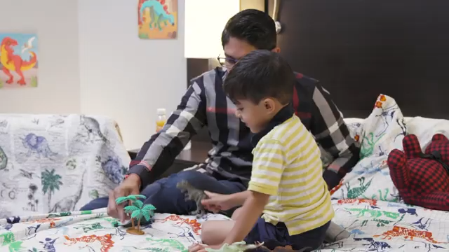
Durante la Visita
Pueda que se le pida que:
Le tome los signos vitales a su niño como el pulso o la temperatura
Cuidadosamente presione el estómago del niño según las indicaciones del proveedor de salud
Realice otros procedimientos, que se le soliciten
Sostenga la cámara de su teléfono o de su computadora sobre las áreas del cuerpo de su niño para que su proveedor de salud pueda realizar un examen a profundidad
Notes:
During The Visit
You may be asked to:
Take your child's vital signs like blood pressure or (explain that you may not need to do this, if you need this equipment and do not have it check with provider)
temperature
Gently push on your child's stomach as instructed by the provider
Perform other procedures, as requested
Hold your phone or computer camera to areas on your child's body so your provider can do a thorough examination
Presenter Suggestions: You may want to share that there are also religious/cultural challenges and families have a right to disclose cultural or religious restrictions that would impact their ability to provide access to the child’s body.
Share that if the doctor is using a secure platform, then your information will be secure.
As you can see from the video- the dad pressing on his son’s stomach where the bandages were
And the mom helping move her child’s wrist for the provider

Slide 33








Consejos Durante la Visita
Para los más jóvenes:
Déle un bocadillo o una comida antes de la visita
Evite programar la cita cuando sea la hora
de la siesta del niño
Lugar cómodo
Tenga disponible el juguete favorito del niño
Tenga disponible un bocadillo o un refresco
Para los mayores:
Coma antes su cita
Encuentre un lugar cómodo (su habitación, su sofá)
¿Cuál es su entorno cómodo (sombrero sobre la cara)?
Tenga a la mano agua o un refresco
Notes:
Some ideas for helping Kids and Teens During the visit:
Younger Ones
Provide a snack or meal before the visit
Avoid scheduling appointment at nap time
Comfortable Location
Have their favorite toy available
Have a snack/drink available
Older Ones:
Eat before your appt
Find a comfortable location (your room)
What is your comfortable environment (hat over face)
Have water/drink nearby

Slide 34

Consejos para los Siguientes Pasos
Al final de su visita, usted y su proveedor de atención médica deberán analizar el diagnóstico y el plan de tratamiento.
HAGA UNA PAUSA y asegúrese de entender y de sentirse cómodo con el plan.
¿Alguna pregunta? ¿El plan satisface las necesidades de su familia?
En el futuro, programe cualquier cita de seguimiento/pruebas /laboratorios
Quién se ocupa de los pedidos y las recetas
Qué referencias pueden ser necesarias y quién las hace.
Para la próxima vez, planifique la visita para que sea un poco más larga o más
corta y comunique qué adaptaciones se podrían hacer para la próxima visita.
Si después de que terminara su visita, usted todavía tuviera alguna pregunta o inquietud, comuníquese con el consultorio de su proveedor de atención médica.
Notes:
At the end of your visit, you and your healthcare provider can: Discuss diagnosis and treatment plan.
PAUSE and make sure you understand and are comfortable with the plan.
Any questions? Does the plan meet the needs of your family?
Schedule any future follow-up appointments and any needed testing or labs
Discuss who is taking care of orders and prescriptions
Discuss what referrals might be needed for further care, support or to other providers and who is making them.
Plan visit for little longer/shorter for next time and communicate what accommodations could be made for next visit.
After The Visit Tip
Once you hang up the phone or disconnect from the computer or device, we are in the AFTER the VISIT section.
If you have any questions or concerns after your visit has ended, contact your health care provider's office.

Slide 35

Los Aspectos Principales de la Telemedicina
¡Puede conectarse!
¡Tiene un dispositivo!
¡Tiene formas de ver a su proveedor de salud y está preparado para su visita!
¡Sabe qué hacer!

Slide 36

¡Por favor, tómese un minuto y complete esta breve Evaluación!
https://redcap.link/FVCurriculum-ES
Notes:
Translate*

Slide 37


¡Gracias!
¡Contáctenos en PEAL si tuviera alguna pregunta
o si necesitara más información o ayuda!
info@pealcenter.org
1-866-950-1040

