Slide 1

The Big Three Accessibility Features Across Platforms
Scott A. Dougherty
scott.dougherty@aiu3.net
@pghskip

Slide 2


Getting to Know Each Other
Scott
The Audience
The learner(s) you are supporting?
What are those learners using?
Direct support during online learning?

Slide 3

Objectives for the Day
Introduction to:
  WHAT features exist in Windows, Mac, iPads, and Chrome/Google
  WHY these features can be beneficial in online learning environments
  HOW to use find and use the features on the devices and programs at their fingertips
Public Domain

Slide 4
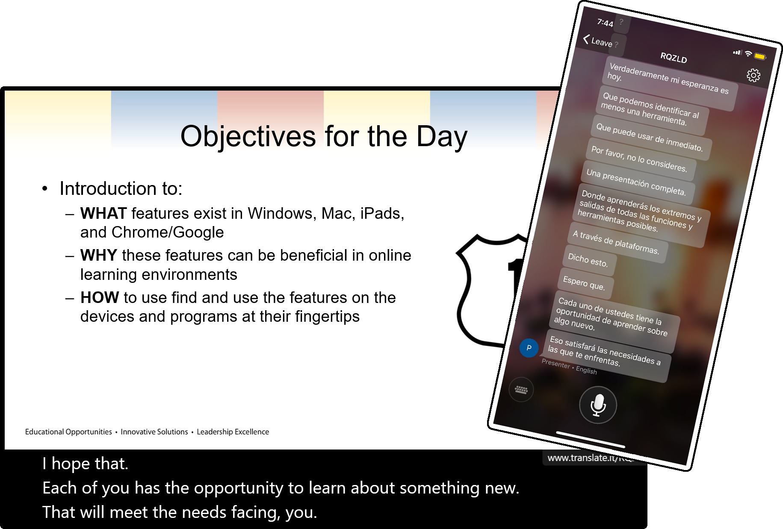
Microsoft Subtitles
Download Microsoft Presentation Translator add-in for PowerPoint
  Using Microsoft Translator in a presentation (Microsoft Support Document)
Download Microsoft Translator app

Slide 5
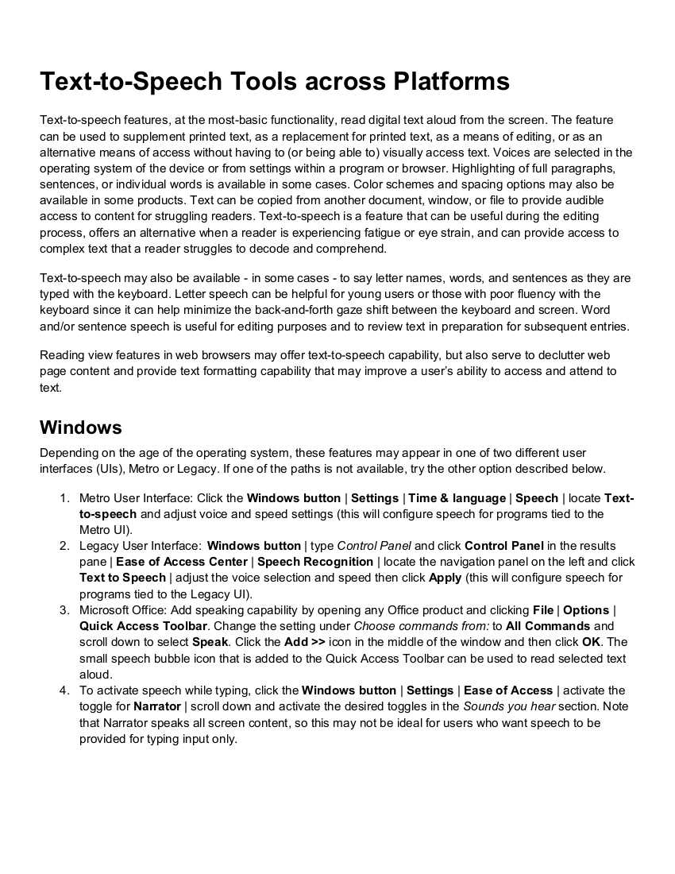
Text-to-Speech Across Platforms
Uses the computer to read print aloud
Synthesized voice allows for changes to speed, pitch, etc.
Puts the power to access text into the user’s hands
  Listening comprehension
  Editing work
  Personal preference
See Big Three Features Across Platforms.pdf (in the Additional Resources and Webinars folder)

Slide 6
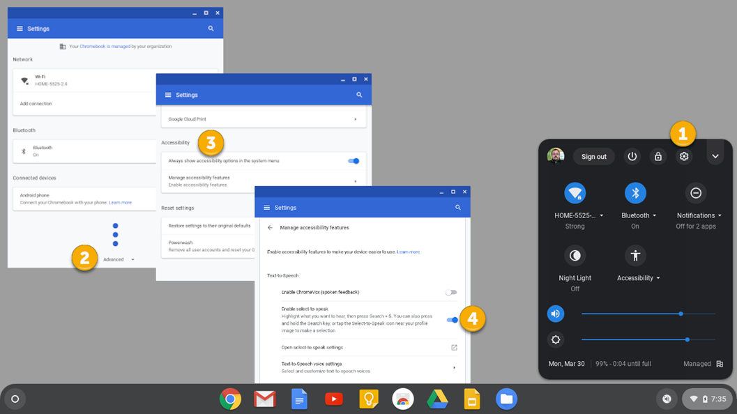
Text-to-Speech in ChromeOS
Click in the lower-right corner of the Shelf and click the Settings icon
Click Advanced and scroll to Accessibility
Enable Always show accessibility options in the
Click Manage accessibility features and Enable select-to-speak

Slide 7
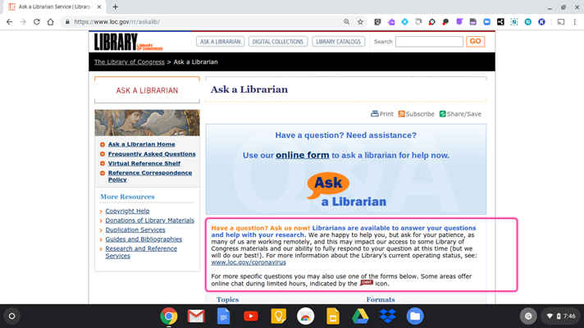
Text-to-Speech in ChromeOS (cont.)
Click the Select-to-Speak icon in the Shelf
  Drag a box around text
  Click where text begins
Click the icon again to stop speech

Slide 8
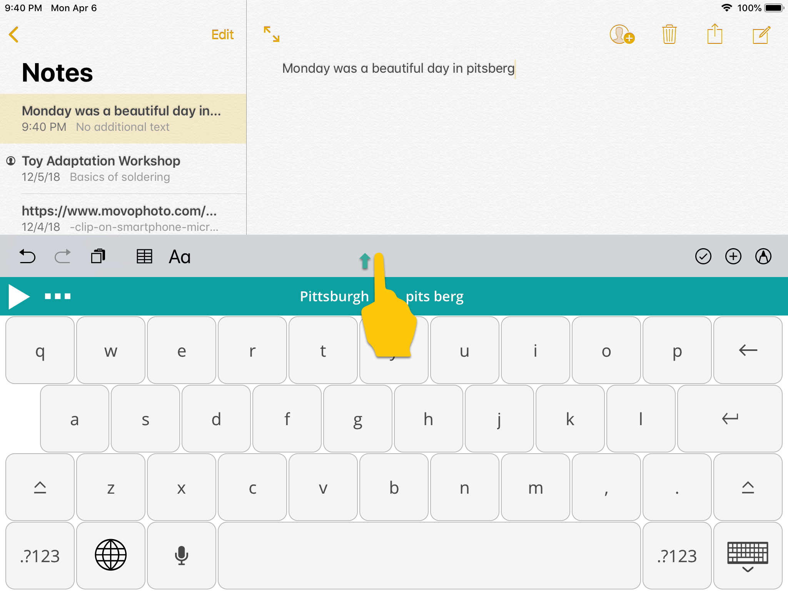
Text-to-Speech Tools from Texthelp
Read & Write for Teachers
Full, free access
EquatIO is also provided free to teachers
Read&Write for Google
30-day trial
Limited features endure after expiration
  Text-to-speech
  Dual-color highlighting (yellow/blue)
Read&Write for iPad
Installs as an external keyboard for use with Google Docs (and all other text entry)
  Text-to-speech
  Word prediction (swipe up)

Slide 9
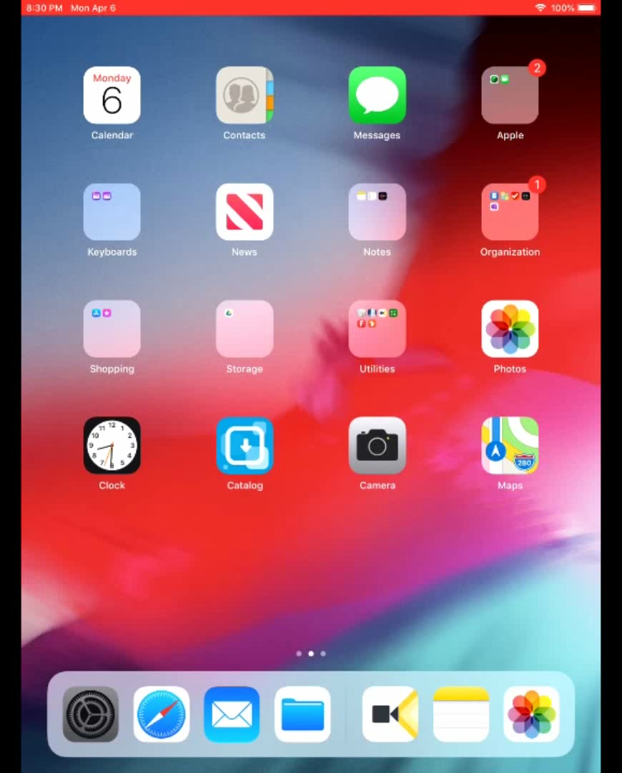
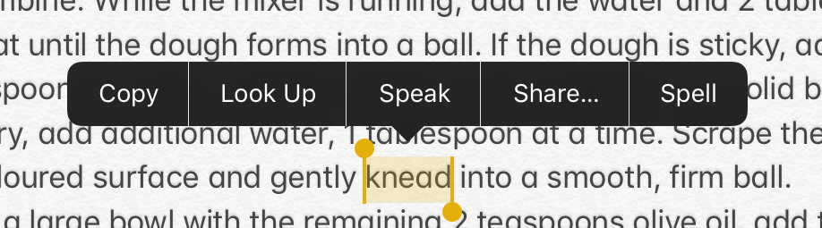

Text-to-Speech in iOS
Click Settings | General | Accessibility | Vision (Speech)
  Enable Speak Selection to display Speak when a long-hold is done on text
  Enable Speak Screen to activate a two-finger swipe from the top of the device to read continuously

Slide 10
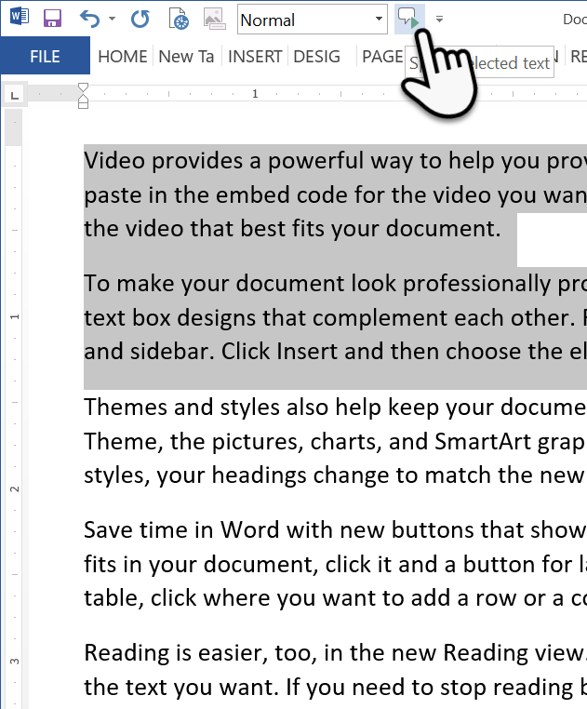
Text-to-Speech in Microsoft Office
Allows users to add a Speak icon to the Quick Access Toolbar and/or the Office Ribbon
  Works for all programs in Office Suite
  Must be added in each program separately
See Text-to-Speech in Microsoft Office.pdf (in the Additional Resources and Webinars folder)

Slide 11
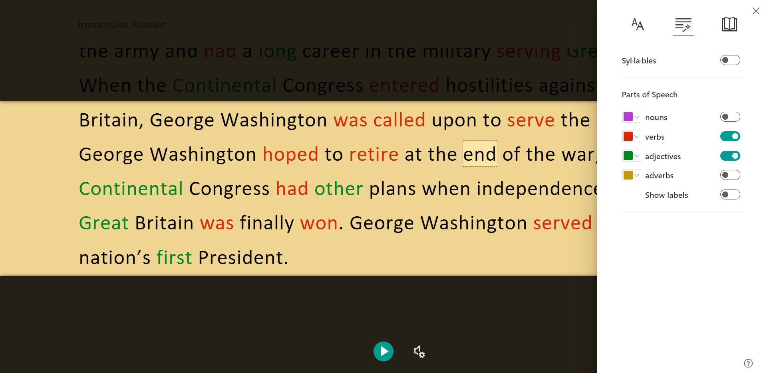
Immersive Reader in Microsoft Office 365
Text-to-speech
Color options
  Text & background
  Grammar
Picture dictionary
Translation
  By word
  By document
Spacing & line focus
Visit Improve Reading & Writing - Microsoft Education on the web for more information

Slide 12
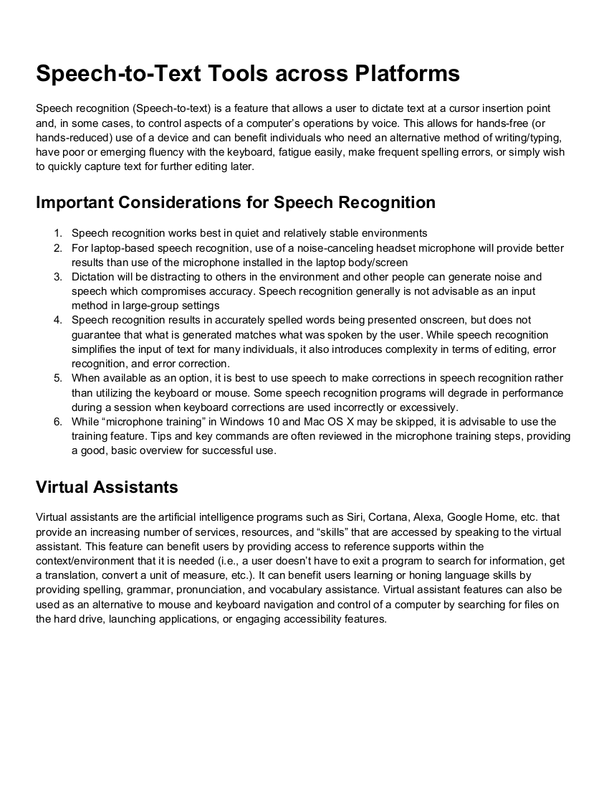
Speech-to-Text Across Platforms
Allows students to type using their voice
Option to augment or replace the keyboard
Not ideal for group settings
Requires no microphone training
Best when dictating full phrases or sentences
See Big Three Features Across Platforms.pdf (in the Additional Resources and Webinars folder)

Slide 13
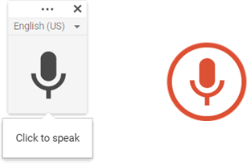
Voice Typing in Google Docs/Slides
Google Docs
Click Tools | Voice typing | click the microphone icon to enable/disable the microphone
Google Slides
Click Tools | Voice type speaker notes
Use Ctrl+Shift+S to automatically start Voice typing with the mic enabled

Slide 14
Speech Recognition on Mac/PC
Speech recognition is built into MacOS and Windows
Microphone training is minimal
Commands also allow for some navigation and editing
  Undoing errors
  Selecting text
  Correcting errors
  Works with Virtual Assistants (Siri and Cortana) for added functionality
See pages 12 & 13 of Tip Sheet 32 - UDL Tier 1 Computing Supports.pdf (in the Additional Resources and Webinars folder)

Slide 15
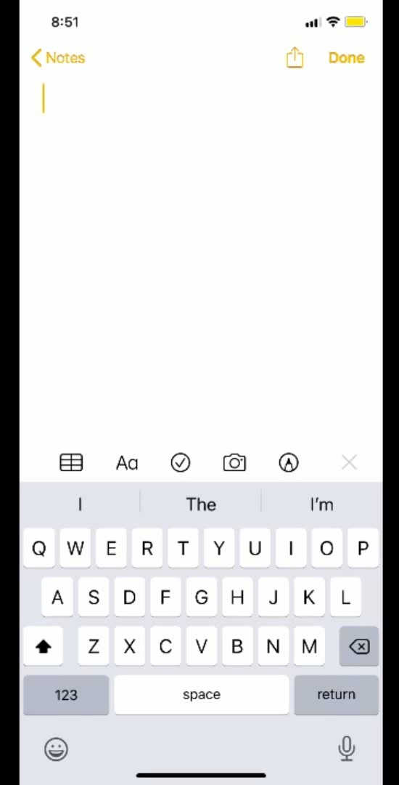
Dictation in iOS
Embedded into the keyboard
Dictate punctuation marks
Say “New line” to move down one line
Say “New paragraph” to move down two lines

Slide 16
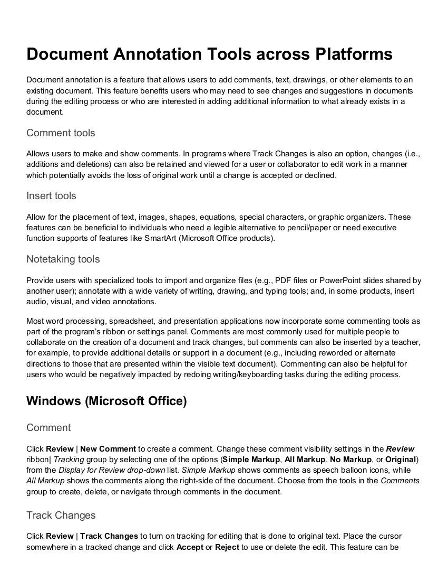
Annotating PDFs
Alternatives to the pencil
  Camera
  Keyboard
  Mouse
  Drawing/annotation tools
Allows student to virtually "write" on PDF files
See Big Three Features Across Platforms.pdf (in the Additional Resources and Webinars folder)

Slide 17
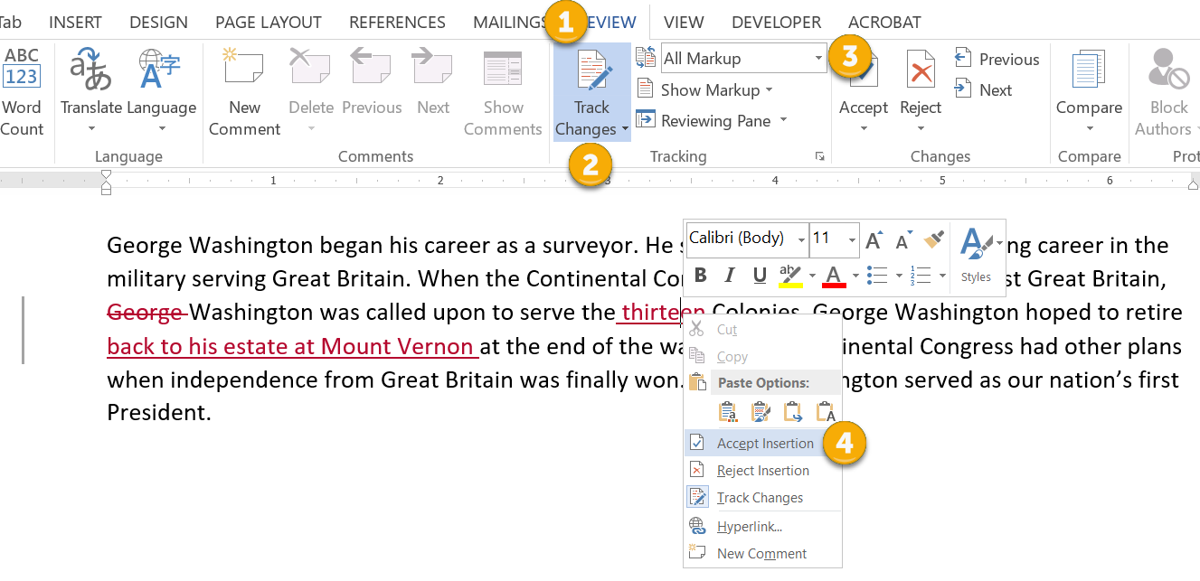
Commenting & Review Tools
Click the Review ribbon tab’s Tracking group
Select Track Changes
Choose to show All Markup
Right-click to accept or reject
See Big Three Features Across Platforms.pdf (in the Additional Resources and Webinars folder)

Slide 18
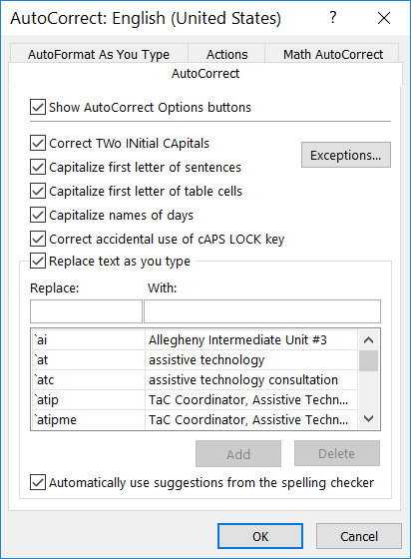
Replace Abbreviations
Click Edit | Find and replace (or press Ctrl+H) to replace abbreviations/errors
Docs: Click Tools | Preferences | Substitutions to add abbreviations for the most highly used phrases
Word: Click File | Options | Proofing | AutoCorrect Options… to add abbreviations for the most highly used phrases
Explore using Abbreviations in Action.docx (in the Additional Resources and Webinars folder)

Slide 19

Portable Document Format (PDF)
Image-only PDFs
PDFs with Selectable Text
Accessible PDFs
Secure PDFs
See Tip Sheet 24 - Annotating PDFs with Acrobat Reader.pdf (in the Additional Resources and Webinars folder)

Slide 20
Features of Adobe Acrobat Reader
Text-to-Speech
Click View | Read Out Loud | Activate Read Out Loud (or press Ctrl+Shift+Y)
  Then click View | Read Out Loud to use the speech controls (keyboard shortcuts follow)
    Press Ctrl+Shift+V to read the current page
    Press Ctrl+Shift+B to read to the end of the document
    Press Ctrl+Shift+C to pause reading
    Press Ctrl+Shift+E to stop reading
    Press Ctrl+Shift+Y to deactivate Read Out Loud
If the feature does not work
Click Edit | Preferences | Security (Enhanced) | uncheck Enable Protected mode at start up
Close the application.
Restart Adobe Acrobat Reader
Try activating Read Out Loud again
Run a repair installation, if necessary

Slide 21
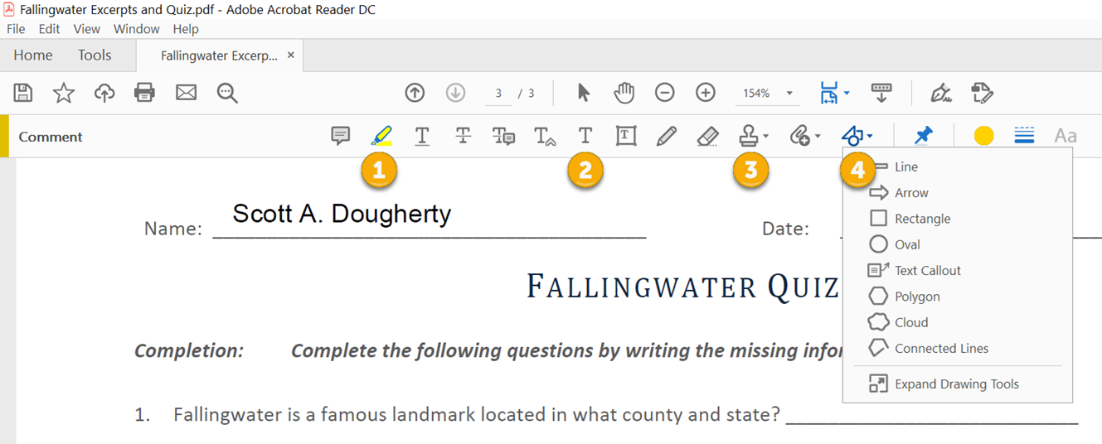
Annotating with the Comments Tool
Click View | Tools | Comment | Open
Highlight text
Add text comment
Add stamps
Drawing Tools
See Tip Sheet 24 - Annotating PDFs with Acrobat Reader.pdf (in the Additional Resources and Webinars folder)

Slide 22
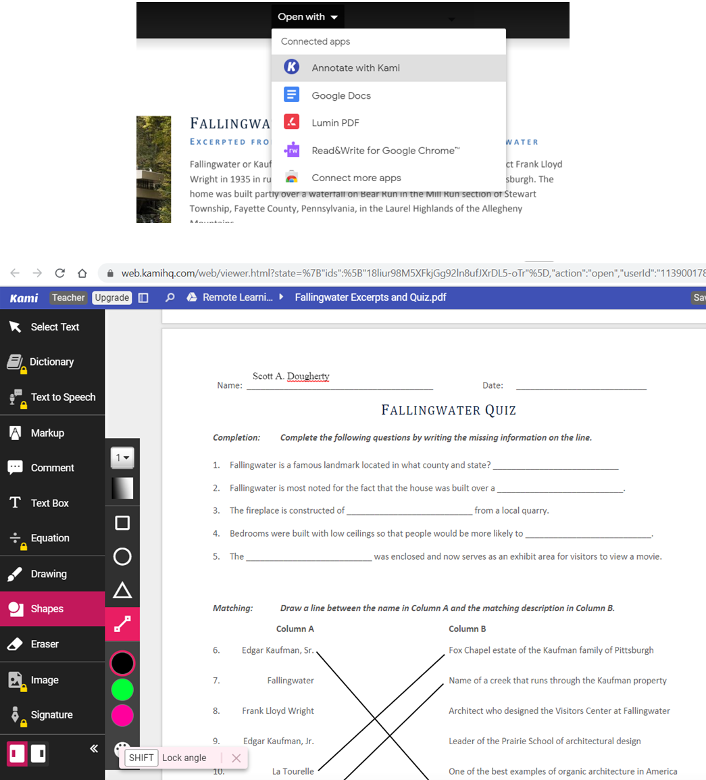
Annotate with Kami
Runs on Google Chrome browser, Google Classroom, and ChromeOS
  Launch Google Drive
  Open a PDF file
  Click Open with | Annotate with Kami
Kami Trial
  After expiration, a majority of tools remain available

Slide 23
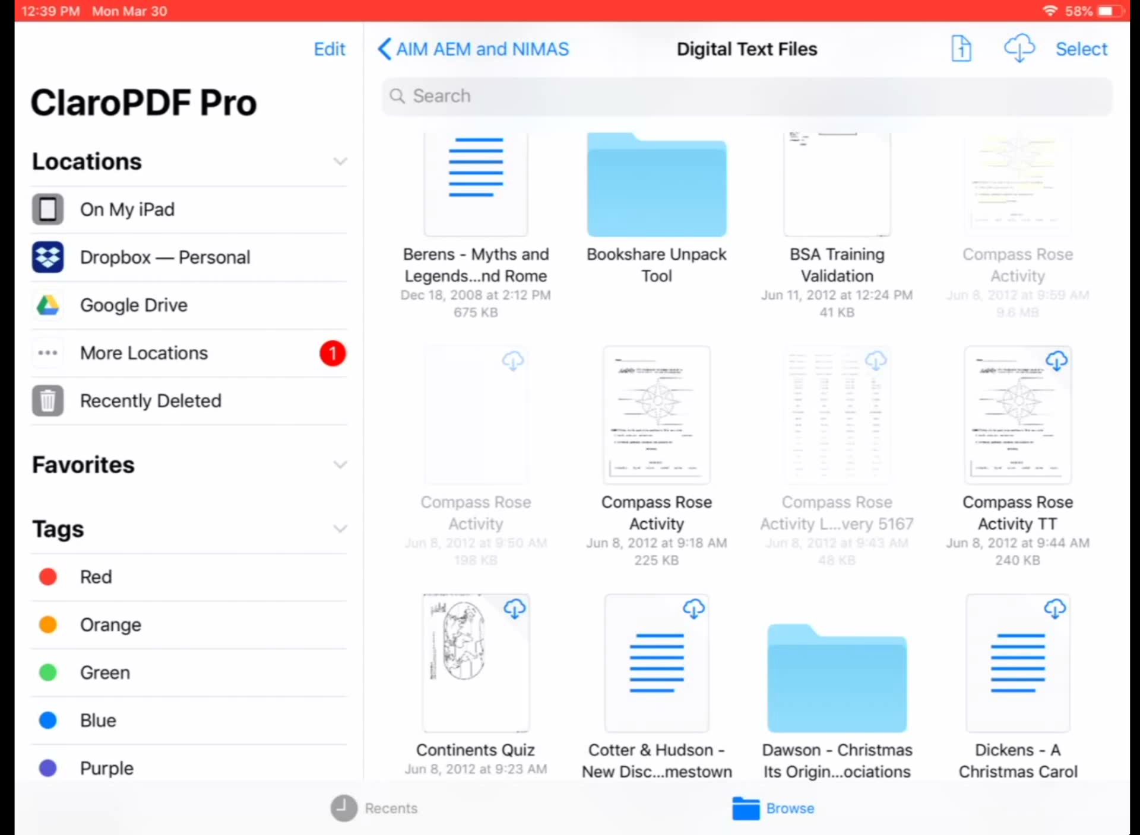
Claro PDF Pro
iPad app with various sharing options
  Local file (on iPad)
  iCloud Drive
  Dropbox
  Google Drive
  AirDrop
  Send as mail
Credits allow the optical character recognition (OCR) conversion of image PDFs
Claro PDF Pro (iOS)

Slide 24
Credits & Resources
Icons8. (2020). Messaging poll topic icon [PNG image]. Retrieved from http://icons8.com/
Microsoft. (2020). Improving reading & writing – Microsoft education [ Web page}. Retrieved from https://www.microsoft.com/en-us/education/products/learning-tools

Slide 25

Next Week’s Webinar
Thursday, April 16, 2020 at 12:00 and 7:00 pm
Specially Designed Instruction (SDI) while Learning from Home
Join us to learn:
  Key points from the annotated IEP
  Various types of SDI
  Differences between accommodations & modifications
  Examples of SDI that can be delivered virtually
Register at http://bit.ly/PEALA16
Please share with others who would benefit from participating!

Slide 26
Evaluations
You will get an email in 1 hour with the link to complete the Webinar Evaluation.
We have received wonderful feedback from previous evaluations.
Please share any comments or questions, as we read them all!
If you don’t want to wait an hour, the link is:
https://www.surveymonkey.com/r/PEALwebinareval

