Slide 1
Specially Designed Instruction for Learning at Home
April 16, 2020
12:00 pm and 7:00 pm
Notes:
JB
12:00
7:00
Welcome – I know that we have families and professionals on the webinar today.
When we asked families to prioritize topics that they need additional information about, providing specially designed instruction to children who are now learning at home. While we don’t want families to feel additional pressure, we wanted to gather some key information and ideas that would help IEP teams think “outside the box” when collaborating to identify ways that special education supports and services can be provided at home. We recognize that there will be some supports and services that are challenging to deliver via distance learning but we hope that some of the information we share today will spark ideas of possibilities.

Slide 2

Interact with us - Guidelines
If you have a question that you would like answered, type it into the “Question” pane.
  We will respond during the webinar to those that we are able to or afterward
  We may have to reach out and get answers from partners
If you have information or resources you want to share with everyone, type them into the “chat” box and chat to everyone
We will also periodically be asking you to respond to polls during the webinar – these questions are primarily targeted to the family members who are participating today.
Let’s start with a quick poll to see who has joined us
Notes:
JB
The responses to the polls will inform us at PEAL about how we can help – identifying or developing resources; changing outreach strategies, delivering training content via webinars etc.
We will also summarize the themes and share them with BSE
Polls – ages of kids
Handouts
PPT slides

Slide 3
Participants will be able to:
Define Specially Designed Instruction (SDI)
Describe types of SDI
Identify potential changes to the SDI in your child’s IEP
Create a plan for discussing needed changes with your school team
Notes:
JB
Our objectives today are to share basic information about the definition of specially designed instruction or SDI, provide a framework for thinking about different types of SDI and help families think about which SDIs might need to change in preparation for discussing ideas with the school team.

Slide 4
Statement from Bureau of Special Education
“It is PDE’s expectation that all LEAs are providing planned instruction through a Continuity of Education Plan and FAPE is provided to students with disabilities to the greatest extent possible which is reasonable and appropriate in light of the circumstances. All school entities are required to submit a Continuity of Education plan. We are monitoring the submissions and the majority have already submitted plans. We will be following up with any district that does not submit a plan. We are attending LEA special education leadership meetings across the state over the few weeks to provide emphasis to our guidance.”
5 Things to Know: PDF from Ed Law Center-handout
PDE Guidance
Notes:
JB

Slide 5

Important Points to Remember
Families are facilitating learning, not responsible for delivering instruction
IEP team must consider the ability and needs of the family as they plan for instruction to be facilitated at home
Make a “good faith effort”
Notes:
Cindy
Enrichment or Planned Instruction—which is it?
Enrichment is work to stay engaged, it is work that is already learned.
Planned Instruction is new learning. New concepts must be taught by a certified teacher. If you don’t know what your school is providing now, ask that question.
Your district should have developed a “Continuity of Learning” plan which is a public document and should be on your SD website.
Your job is anything from providing work space to helping with assignments or anything in between. It is about making the instruction work and troubleshoot with the school any problems your child might have learning the material. This might vary according to the needs of your child.
Again, these are unprecedented times, if you find that it is impossible for your child to work virtually—that is ok. This is not a learning style for every child. Make sure to document with the school that you have tried distance learning, but it is not working for your child. Have an IEP meeting to discuss the issue.
Good faith effort--
In doing this, you will help ensure your child will receive the education they need, possibly compensatory education (make-up education), for what your child missed during this time.
POLL – Enrichment, Instruction, both, neither, not sure

Slide 6
Important Points to Remember
Supreme Court Justice Roberts writes,
“The IDEA demands more. It requires an educational program reasonably calculated to enable a child to make progress appropriate in the light of the child’s circumstances.”
To be clear, the term “circumstances” applies to the child’s ability and potential – not to the closure of schools due to the pandemic.
Notes:
Cindy
IDEA is federal law that every state MUST follow.

Slide 7
Important Points to Remember
When you have an IEP meeting to address the “interim” special education services, these sections of the IEP are most important:
Goals, Progress Monitoring
SDI
Notice of Recommended Educational Placement/Prior Written Notice (NOREP/PWN)
Notes:
Cindy
The goals and SDI are the most important parts of the IEP right now. These are the areas that will potentially change the most during the current situation.
Progress Monitoring is the data that is collected *by the school* to determine the progress the child is making towards their goal
SDI supports the child while learning and helps make progress towards their goals. We will address this in more depth throughout this webinar.
Prior Written Notice is the same document as the Notice of Recommended Educational Placement. At this time, there is NO change in placement for students.
There is, however, a notice that must be issued by the school regarding the changes that are being made because of the current situation. There should have been discussion with you—the parent—regarding these changes. The changes should be individualized to the needs of your child.

Slide 8

Suggestions for Ongoing Success
Make note of the school district’s solutions to moving from a brick and mortar setting to a virtual one.
Feel welcome to offer creative solutions and brainstorm with the school to come up with SDI that will work in a virtual setting.
Have a plan to present your child’s needs and your creative ideas to the others on the IEP team.
Notes:
Cindy
We are trying to be sure children are getting what they need at this time
Review points on slide
In addition, teams may need to go “back to the drawing board” if their first ideas don’t work for the student or the family.

Slide 9
Annotated IEP
Specially Designed Instruction
Notes:
JB
There are several factors to consider in developing SDI for a student. As long as it is listed in the IEP, it must be provided.
Annotated means “with notes” - Entire annotated IEP is on PaTTAN website
NOTE: Do not be overly concerned about the category of the items you write into this section (e.g. does this service/activity fall under the category of
SDI, modifications, or supplementary aids and services?).
Instead, include what the student needs and write it in where you believe is the most
appropriate location.

Slide 10
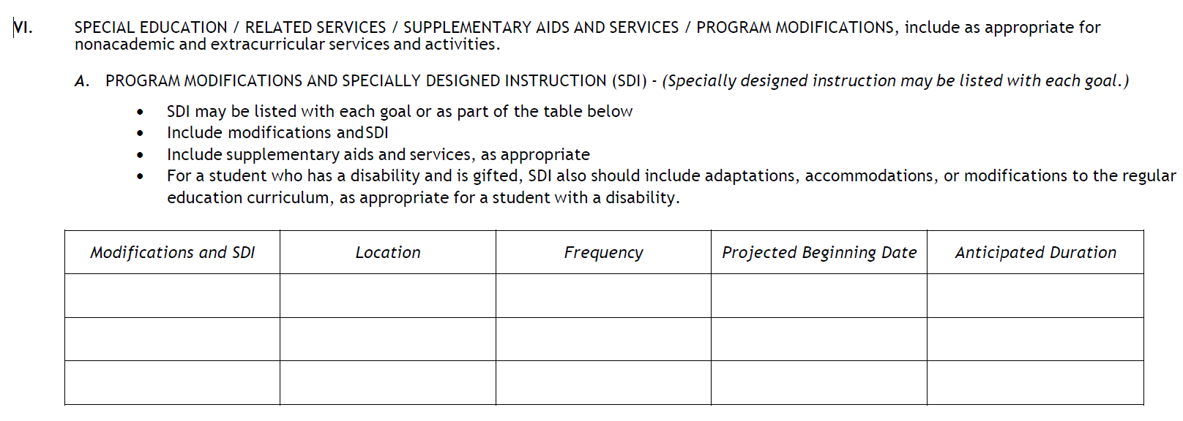
Special Education =
Specially Designed Instruction
Notes:
JB
Special Education means Specially Designed Instruction, at no cost to parents, to meet the unique needs of a student with a disability
This slide shows the section of the IEP called “Program Modifications and Specially Designed Instruction”
As you can see, Specially Designed Instruction may be listed with a goal if it is specific to that goal or can be listed in this section of the IEP.
To learn more about Specially Designed Instruction on the IEP, check out the section of the Annotated IEP that we have uploaded as a handout.

Slide 11
Specially Designed Instruction
adapting…the content, methodology, or delivery of instruction
to address the unique needs of the child that result from the child’s disability, and
to ensure access of the child to the general curriculum
Most SDI falls into two categories:
Accommodations - Changes how the child learns
Modifications – Changes in what a student is expected to learn
  changes in instructional level, content, and performance criteria
Notes:
LB
On the slide, we have provided definitions of some key terms related to Specially Designed Instruction, Most SDI falls into one of two categories:
Accommodations level the playing field for students with disabilities by allowing changes to how the student learns but DO NOT change the learning expectations
Extended time for tests, use of a calculator or laptop, etc.
Modifications change the content that a student is expected to learn – modifications reduce the depth, breadth and/or complexity of learning expectations
Shorter, easier reading assignments, different and/or fewer spelling words, etc.
To learn more about accommodations and modifications go to the link on the resource slide that takes you to a resource on Understood.org.

Slide 12
Examples
Accommodations
Modifications
Listening to an audio version of a book
Viewing a video about a science concept
Using a keyboard to write
Extra time to complete tests or assignments
Enlarged text
Complete different homework than peers
Learn only the “big ideas” of a science lesson
Graded or assessed using a different standard than others
Notes:
LB
We have listed some examples of Accommodations and Modifications here.
The critical point about the accommodations is that while listening to an audio recording or viewing a video is that the learning goal is the same as for all students.
Modifications can include things like having different homework than peers (for example, only working on single digit addition problems while other students are working on single and double digit problems)

Slide 13
Access to Instructional Materials
Access to written materials must be provided to students who have “print disabilities” at the same time as peers receive them
Access can be provided via:
  Alternate accessible formats (e.g., on a computer with screen reader software)
  Specialized formats (e.g. Braille, audio, large-print, etc.)
Notes:
LB
For students with print disabilities, access to written materials; such as a book, novel, workbook, must be provided at the same time as when peers receive it.
Print disabilities = a disability that makes it difficult to access visual impairment, intellectual disabilities
This may be even more important as students are learning virtually.
Access may include providing instructional materials in alternate accessible formats or specialized formats (that is, braille, audio, digital, large-print, etc.) in a timely manner.
Add Bookshare to the resource slide

Slide 14
Supplementary Aids and Services
Aids, services, and other supports
Provided in regular education classes, other education-related settings, and in extracurricular and nonacademic settings
To enable students with disabilities to be educated with nondisabled students to the maximum extent appropriate
Purpose is to support students with disabilities as active participants with nondisabled peers as well as to enable their access to the general curriculum.
Notes:
JB
This is the umbrella term for supports that are provided to a student with a disability to access the general education curriculum and instruction to the maximum extent possible in light of the child’s circumstances.
As we mentioned earlier, It is most important to identify what the student needs and list it where you believe is the most appropriate location.
Do not be overly concerned about whether a service or activity should be listed as SDI, Modification or supplementary aids and services
For more details, take a look at the SaS Fact sheet handout that is uploaded
Background for Trainers:
• Supplementary aids and services are to be based on peer-reviewed research to the extent practicable.
• “Peer-reviewed research” generally refers to research that is reviewed by qualified and independent reviewers to ensure that the quality of the information meets the standards of the field before the research is published.
• “To the extent practicable” means that services and supports should be based on peer-reviewed research to the extent that it is
possible, given the availability of peer-reviewed research. This does NOT mean that the service with the greatest body of research is
the service necessarily required for a child to receive a Free Appropriate Public Education (FAPE).
• The failure of a public agency to provide services based on peer-reviewed research would not automatically result in a denial of FAPE.
There is nothing in the law requiring that all elements of a program provided to a student be included in an IEP. It is an IEP team decision regarding which instructional methodologies are required based on an individual student’s needs. Therefore, if an IEP team determines that specific instructional methods are necessary for the student to receive FAPE, those instructional methods may be
addressed in the IEP.
[A student with a disability is not to be removed from regular classrooms solely because of needed modification in the general curriculum.
Federal law mandates that, “Special classes, separate schooling, or other removal of children with disabilities from the regular educational environment occurs ONLY if the nature or severity of the disability is such that education in regular classes with the use of supplementary aids and services cannot be achieved satisfactorily.”]

Slide 15
Supplementary aids and services should be:
Available to all students who need them
Designed to provide meaningful educational benefit
Provided in a manner that avoids stigmatizing students
Notes:
JB
These points emphasize the importance for IEP teams to work together to identify supports that can be delivered virtually and provide meaningful educational benefit

Slide 16
Access to the General Education Curriculum
Providing students with disabilities the right to the same state, district and school curriculum that is provided to students without disabilities
Supplementary Aids and Services and SDI help to ensure successful inclusive education
Notes:
LB
With the school buildings closed and everyone at home, schools should still be providing students with access to the general education curriculum and we can still ensure that schools are providing inclusive education and practices.
Schools have been guided to provide the same level of access to the general education curriculum as when students were in the brick and mortar setting.
Specially Designed Instruction and Supplementary aids and services are ways to provide supports to enable access.

Slide 17
Examples of SDI
Notes:
Ana and Kathleen
We are hoping these ideas and examples spark some ideas for you to discuss with your IEP team

Slide 18
Types of SDI
Environmental/Physical
Organizational
Testing and Assignments
Instructional
Behavioral
Social
Collaborative
Notes:
Ana
The categories of SDI on this slide are a way to think about SDI with your team.
As IEP teams collaborate to identify ways to meet student needs for specially designed instruction, it is possible that a different type of SDI might be added to existing SDI in order to meet the need of the child
It is important to remember the “why” of the SDI when identifying SDI that can be delivered virtually
For example, many students have preferential seating listed as an SDI but it can be for many different reasons to meet many different needs – we must first consider what need the SDI is meeting in order to develop ideas for providing it while learning at home. One child may need to be close to the materials due to a visual impairment, another child may need to be seated in a way to reduce distractions. These needs may be met differently at home.
Let’s look at some examples of how an IEP team might change or add SDI to meet the child’s needs during virtual instruction
POLL – WHAT ARE THE TOP 3 YOU ARE CONCERNED ABOUT FOR YOUR CHILD/STUDENTS?

Slide 19

1. Environmental/Physical
Adaptations and modifications to the physical environment
Provided when school buildings are open:
  Adaptive equipment
    Low tech: adapted paper, slantboard, special seating, wedges
    High tech: FM systems, Computer, iPad, Wi-Fi (hot spots), online platforms
Possible virtual support:
  IEP team assists the family to create a virtual learning environment that meets the student’s needs
Notes:
Ana
These are adaptations and modifications to the physical environment – many children have this type of SDI in their IEP to support their learning
Schools are responsible for ensuring that the student has access to any adaptive equipment, communication devices such as, iPad, computer, worksheets, adapted paper, slantboards and others
In addition to providing the low tech physical supports and high tech equipment materials that a student needs, the Family/educator (team) could meet to have the conversation of how to create a physical learning environment at home that will support the child to learn virtually
How can we create a learning environment in the home based on the family’s needs?? This is important piece of communication at this time

Slide 20

2. Organizational
Supports and instruction teach students to plan, organize and execute tasks
Provided when school buildings are open:
  Check in and check out with teacher(s)
Possible Virtual SDI:
  Individualized 3 minute instant message by teacher
  5 minute alarm check in “pop up”
  Agenda prompts
    link schedule reminders to a child’s calendar
Notes:
Ana
Organizational SDI support students in planning, organizing and executing tasks – many students have need for these types of SDI
Things like graphic organizers, homework folder checks, written schedules and others are examples of organizational SDI
In the school building, a student might have a planned check-in with a teacher at the beginning and end of a class – the purpose of this check in is so that the student has a clear understanding about the expectations for the class, can ask questions, and understand assignments
As students are learning virtually, this kind of SDI might be provided using an individualized instant message from teacher, 5 minute alarm check in, or agenda prompts linked to the teen’s calendar on their phone
We need to be creative about considering ways that the student’s needs can be met

Slide 21

3. Testing and Assignments
Accommodations of where and duration; modification of work
Provided when school buildings are open:
  Extended time
Possible Virtual SDI
  No change may be needed because extended
  time can still be provided but expectations
  need to be clear to the child and the
  family
Notes:
Ana
SDI may allow for changes to where testing is done, how long a student spends on a test, and due dates for assignments
Examples of SDI for testing and assignments at school could be to provide extended time or chunk the assignment or allow kids to retake assignments
In this case, extended time can still be provided while children are learning at home; Organizational SDI support students in planning, organizing and executing tasks – many students have need for these types of SDI
Things like graphic organizers, homework folder checks, written schedules and others are examples of organizational SDI
In the school building, a student might have a planned check-in with a teacher at the beginning and end of a class – the purpose of this check in is so that the student has a clear understanding about the expectations for the class, can ask questions, and understand assignments
As students are learning virtually, this kind of SDI might be provided using an individualized instant message from teacher, 5 minute alarm check in, or agenda prompts linked to the teen’s calendar on their phone
We need to be creative about considering ways that the student’s needs can be met
owe
It is important that the expectations or amount of extended time must be clear to the child and the family, the teacher may need to provide
A student who is expected to complete an assignment or test “live” with teacher on Zoom and they need extended time could be given option to take more time, record their response and submit it later.
You can be creative when providing SDI for learning at home

Slide 22

4. Instructional
Development and delivery of instruction that addresses diverse learning needs
Provided when school buildings are open:
  Modified Instruction – use of evidence-based
  multi-sensory reading intervention
Possible Virtual SDI:
  Identify an evidence-based intervention
  that can be delivered through distance
  learning
Notes:
Kathleen
Instructional supports involve providing instruction in ways that address diverse learning needs.
When school buildings are open, some students may be receiving modified instruction via an evidence-based multi-sensory reading intervention
When students are learning at home, the IEP team will need to identify ways that the evidence-based intervention could be delivered
For example, if an intervention requires 45 minutes a day of direct instruction, that could be scheduled to be delivered via distance learning by a teacher each day
Reminder: The IEP team should to discuss the needs and how the intervention can be delivered with fidelity

Slide 23

5. Behavioral
Supports and services to increase appropriate behavior and reduce disruptive or interfering behavior
Provided when school buildings are open:
  Modification of rules and expectations
Possible Virtual SDI:
  IEP team (which always includes the family) reviews the Behavioral Support Plan to identify how it can be provided at home and provide training/coaching to family on implementing strategies
Notes:
Kathleen
Behavioral SDI include supports and services to increase appropriate behavior and decrease behavior that interferes with learning
When school buildings are open one example of how rules may be modified would be that the child is permitted to have fidget at desk during instruction and take sensory breaks outside the classroom
The IEP team could review the Behavioral Support Plan, identify materials needed to provide sensory breaks at home and provide needed materials to the family, teach the family how strategies work and coach as needed, suggest a schedule for sensory breaks, etc.
Some students may feel less pressure/anxiety with virtual learning while other students may feel increased pressure
The team might also consider need for adding other kinds of support, such as counseling

Slide 24

6. Social
Supports and services to increase appropriate social skills and/or emotional regulation
Provided when school buildings are open:
  Social skills instruction
Possible Virtual SDI
  Facilitate video modeling at home and small group virtual conversations
Notes:
Kathleen
Specially Designed Instruction can be provided to meet social needs
If Social skills instruction is provided at school by using video modeling, and facilitating lunch group conversations, then the team needs to figure out how to provide supports virtually to meet the needs.
Some ideas for possible Virtual SDI that might meet those needs are: Video modeling could be used at home but may need to be structured and facilitated by a teacher, and the teacher or SLP could set up and facilitate small group virtual conversations

Slide 25

7. Collaborative
Adults working together to support students
Provided when school buildings are open:
  Scheduled opportunities for parental collaboration
Possible Virtual SDI
  Scheduled coaching and guided support for team members to plan and problem-solve for an individual student
Notes:
Collaborative SDI is about adults working together to support the learning of students
If an IEP includes scheduled opportunities for collaboration with families about their child’s educational services then when learning virtually, that family might need scheduled coaching and support to plan and problem-solve together, especially with the shift to virtual learning.
Note: As families are taking on the role of facilitator of learning, it is even more important for them to have access to professional development that is being offered to educators

Slide 26
Students can have a new approach to…
be active participants in this process,
be self-aware of both their abilities and areas in which they struggle,
be able to self-advocate and state their needs to the adults responsible for creating and providing the programs and services,
be able to provide feedback throughout their education so revisions can be made to the programs and supports as necessary.
Michigan Virtual University
Notes:
Supporting students impacted by disabilities in online and blended programs, at first blush, might appear to be a daunting task. There are many technical, legal, logistical, instructional, and educational considerations that need to be made for effective programs and supports to occur. However, for many students impacted by disabilities, the online and blended learning environment might be an opportunity for them to attend to the academics and supports required for educational achievement through targeted educational opportunities, projects, and supports that online or blended learning might offer them.

Slide 27

Questions
Notes:
JB – read and answer additional questions if time permits

Slide 28
Resources
Deschaine, M. (2018). Supporting students with disabilities in k-12 online and blended learning. Lansing, MI: Michigan Virtual University. Retrieved from https://mvlri.org/research/publications/supporting-students-with-disabilities-in-k-12-online-and-blended-learning/
Accomodations and Modifications – for more information
Notes:
Add Bookshare, link to Understood.org

Slide 29
Evaluations
You will get an email in 1 hour with the link to complete the Webinar Evaluation.
We have received wonderful feedback from previous evaluations.
Please share any comments or questions, as we read them all!
If you don’t want to wait an hour, the link is: www.surveymonkey.com/r/PEALwebinareval

Slide 30
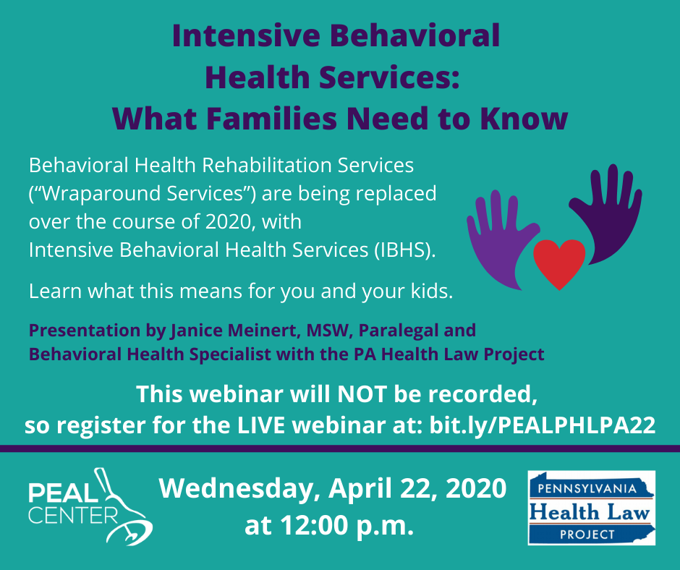
Next Webinar http://bit.ly/PEALPHLPA22
Notes:
JB

Slide 31

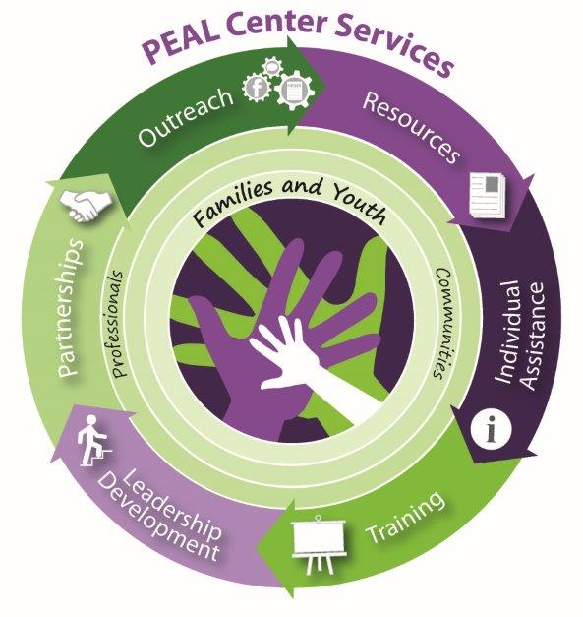
Thank You!
www.pealcenter.org
info@pealcenter.org
1-866-950-1040
Serving families across PA
with offices in Pittsburgh and Philadelphia

